Slide 1
SAND SOURCING
Logistics, Quality, & Price
BISAC May 16, 2023

Slide 2
NC & USFWS Sediment Criteria
15A NCAC 07H .0312 TECHNICAL STANDARDS FOR BEACH FILL PROJECTS
Silt Content
Grainsize
Gravel/ Shell Content
USFWS NORTHCAROLINA REGIONAL BIOLOGICAL OPINION
Sand Color
Compactability

Slide 3
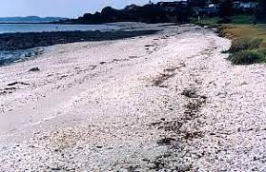
All Sand is Not the Same
Environmental
Color
Grainsize
Shell Content
Engineering
Grain Size
Composition
Grain Shape

Slide 4
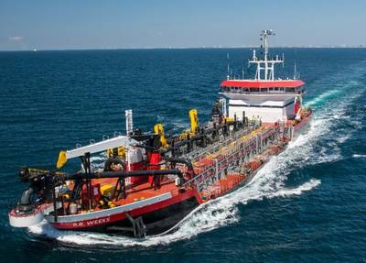
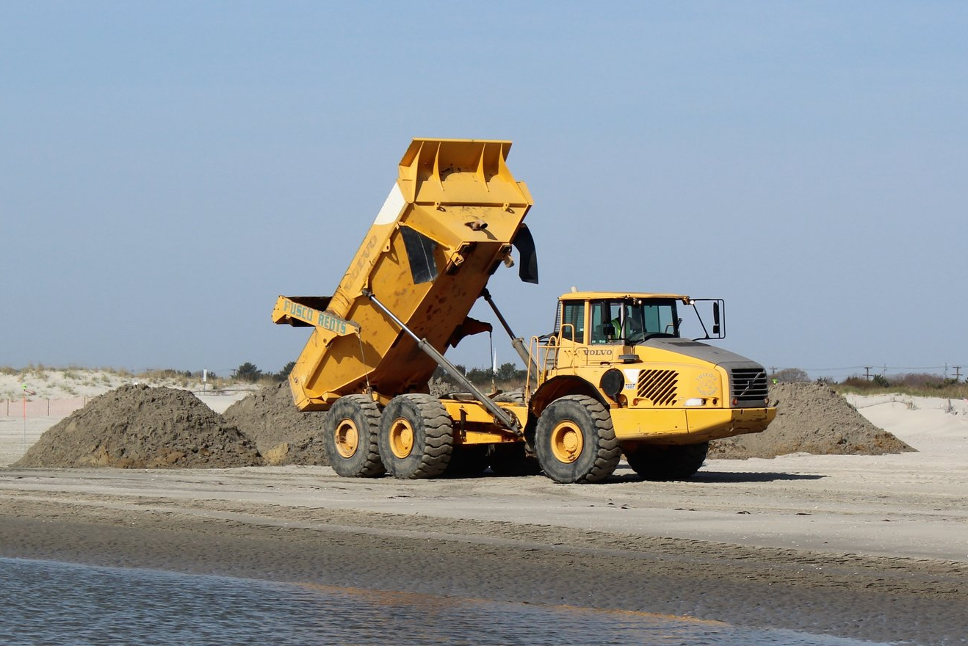
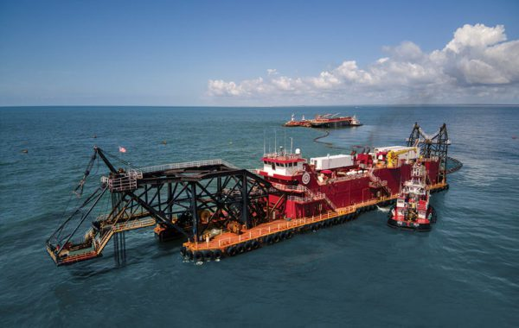
METHODS OF ACQUIRING SAND
Truck Haul
Hopper Dredge
Cutter Suction Dredge

Slide 5
LOGISTICAL DIFFERENCES
Truck Haul
Inexpensive Mobilization BUT High Unit Cost
Sand Washed at the Mine
Grain Size Control
Hopper Dredge
Expensive Mobilization / Moderate Unit Cost
Washes Sand at Borrow Area
Able to Move Sand Long Distance
Cutter Suction Dredge
Expensive Mobilization / Lowest Unit Cost
Able To Work In Shallow Water
Limited Distance (7-8 miles)

Slide 7
Questions?

