Slide 1






30 YEAR PLAN
THE EARLY YEARS
BISAC FEBRUARY 21, 2023

Slide 2
REACH 1
FY 26
REACH 2
FY 26
REACH 3
FY 26
REACH 4
FY 25
REACH 5
FY 24
Beach Reaches

Slide 6
Borrow Area DA143
Approximately 1.9 Million CY
Relatively Easy to Permit
Less Expensive to Use than Offshore Borrow
Sufficient for Reaches 1, 2 & 3 plus
Eligible for Shallow Draft Fund
$5M USACE study on 6 DA rehabs Includes DA 143

Slide 7
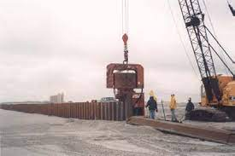
“Temporary” Terminal Groin as a Construction Item
Mason Inlet Example

Slide 8
Design Schedule
30 Year Concept Plan – December 2023
Stand Alone Permit for Reaches 1, 2 & 3 (DA143) - Dec 2023 - Nov 2024
Long Term Sand Source Development Jan 2024- December 2024
Finalization of 30 Year Plan, Including Permit - December 2025

Slide 9
Initial Construction Schedule
Winters FY 24 & FY 25 - Complete Reaches 5 & 4
Winter FY 26 - Complete Reaches 1, 2 & 3 (Maintenance on Reach 1)
Potential for Temporary Terminal Structure FY 26
Initial Inlet Improvement / Maintenance 1, 2 & 3 FY29
Cycle every 4 years w/ Small Hopper Maintenance Annually
Initial Hopper Maintenance FY 32
Cycle every 10 Years

Slide 10
Funding Opportunities
DA-143 – Shallow Draft Fund 3:1 State Match
Maintenance/Borrow from NRI – Shallow Draft Inlet Fund 3:1 State Match
Beach Resilience Fund (aka Reach 4) – State 1:1 Match
Directly Legislated State Grants
FEMA Assistance After Declared Disasters
Other County/State/Federal Opportunities yet Identified
ENOUGH FUNDING OPORTUNIES IDENTIFIED TO
CARRY LONG TERM PLAN WITHOUT CHANGE IN TAX RATE

Slide 11
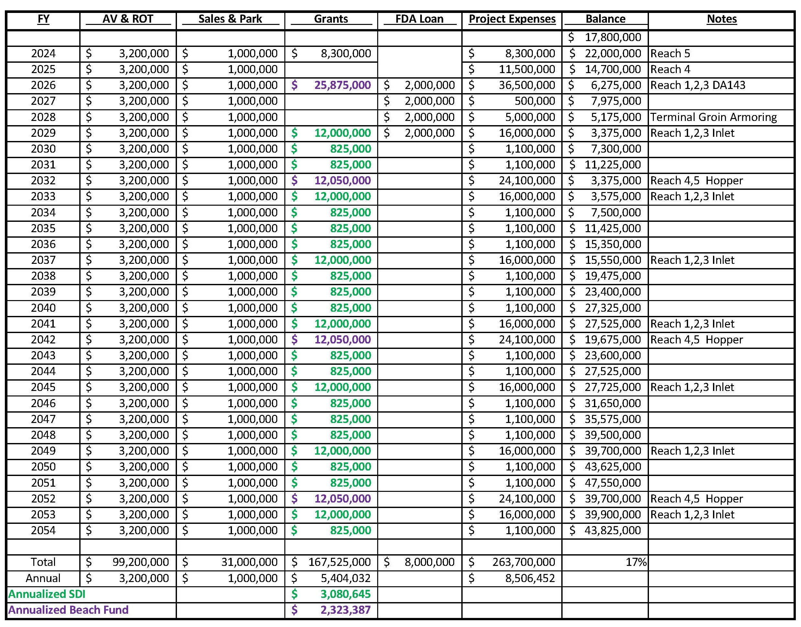

Slide 12
Non-Construction Expenses over FY 24 & FY25
Surveys & Geotechnical Analysis of DA 143 $400,000
Engineering/ Design of Borrow Area $150,000
Environmental Analysis $ 75,000
Permitting/ Grant Applications $150,000
_____________________________________________________________
TOTAL $775,000

Slide 13
Questions?

