Slide 1
Budget workshop 2
Fiscal Year 2023 – 2024

Slide 2
Noteworthy changes
Updated Salary figures
Estimated 5% increase in insurance
Increased Health Reimbursement Account (HRA)
Added 2 floating holidays
Short Term Disability

Slide 3
American rescue plan
Signed into law in March 2021 and provided funding to all states, counties and municipalities across the country
NTB received $236,792.20 in two tranches
Expended $36,408.78 for board room technology
$200,383.42 remaining
Must be obligated by 12/31/2024
Must be spent by 12/31/2026
May NOT be spent on borrowing costs or debt service payments
Staff recommendation for use

Slide 4
General fund summary
 | Total Expenditures: |  | Adopted 07/01/2022 | Proposed | Difference from Current Year
410 | Governing Board |  | $ 240,104.00 | $ 265,604.00 | 10.62%
420 | Administration Department |  | $ 687,783.60 | $ 720,127.35 | 4.70%
430 | Elections |  | $ - | $ 5,000.00 | 100.00%
480 | IT Department |  | $ - | $ 173,609.00 | 100.00%
490 | Planning Department |  | $ 153,649.75 | $ 260,206.30 | 69.35%
491 | Inspections Department |  | $ 350,958.40 | $ 245,817.30 | -29.96%
500 | Public Buildings |  | $ 513,750.00 | $ 388,800.00 | -24.32%
501 | Town Insurances |  | $ 277,500.00 | $ 266,500.00 | -3.96%
509 | Police Separation Allowance |  | $ 17,125.00 | $ 17,125.00 | 0.00%
510 | Police Department |  | $ 1,435,191.00 | $ 1,388,370.35 | -3.26%
545 | Public Works Department |  | $ 641,433.80 | $ 571,600.35 | -10.89%
560 | Public Streets |  | $ 141,000.00 | $ 129,000.00 | -8.51%
580 | Sanitation Department |  | $ 514,524.36 | $ 514,524.36 | 0.00%
620 | Recreation |  | $ 120,750.00 | $ 157,200.00 | 30.19%
690 | Fire Department |  | $ 1,637,369.65 | $ 1,520,497.90 | -7.14%
695 | Committees |  | $ 2,000.00 | $ 2,000.00 | 0.00%
999 | Contingency |  | $ 326,344.80 | $ - | -100.00%
 |  |  |  |  |  | DIFFERENCE:
 |  |  | $ 7,059,484.36 | $ 6,625,981.91 | -6.14% | $ (672,888.45)
 | Total Revenues: |  | $ 7,059,484.36 | $ 7,298,870.36 | 3.39%
Assuming current tax rate of $0.43 per hundred dollar valuation, with $0.26 assigned to the General Fund.

Slide 5
Capital assets within general fund
Exterior of North end fire station:
$150,000
Public Works F450 Dump truck:
$64,000
PUBLIC WORKS Enclosed trailer & MOWER:
$18,100
One police DEPTARTMENT vehicle:
$35,000
one fire department vehicle:
$55,000

Slide 6
Follow up items
Special Events
Pending MOU for Bike Lanes

Slide 7
Capital improvements fund summary
Account Number | Account Description | FY22-23 Approved Budget | Estimated Revenues
12-301-00 | AD VALOREM TAX | $ 990,423.00 | $ 1,072,312.50
 | TOTAL REVENUES | $ 990,423.00 | $ 1,072,312.50
12-750-01 | FIRE DEPT | $ 424,467.00 | $ 459,562.50
12-750-02 | FIRE TRUCK | $ 141,489.00 | $ 153,187.50
12-750-11 | FUTURE CAPITAL IMPROVEMENTS | $ 424,467.00 | $ 459,562.50
 | TOTAL EXPENDITURES | $ 990,423.00 | $ 1,072,312.50
Assuming current tax rate of $0.43 per hundred dollar valuation, with $0.07 assigned to the CIF.

Slide 8
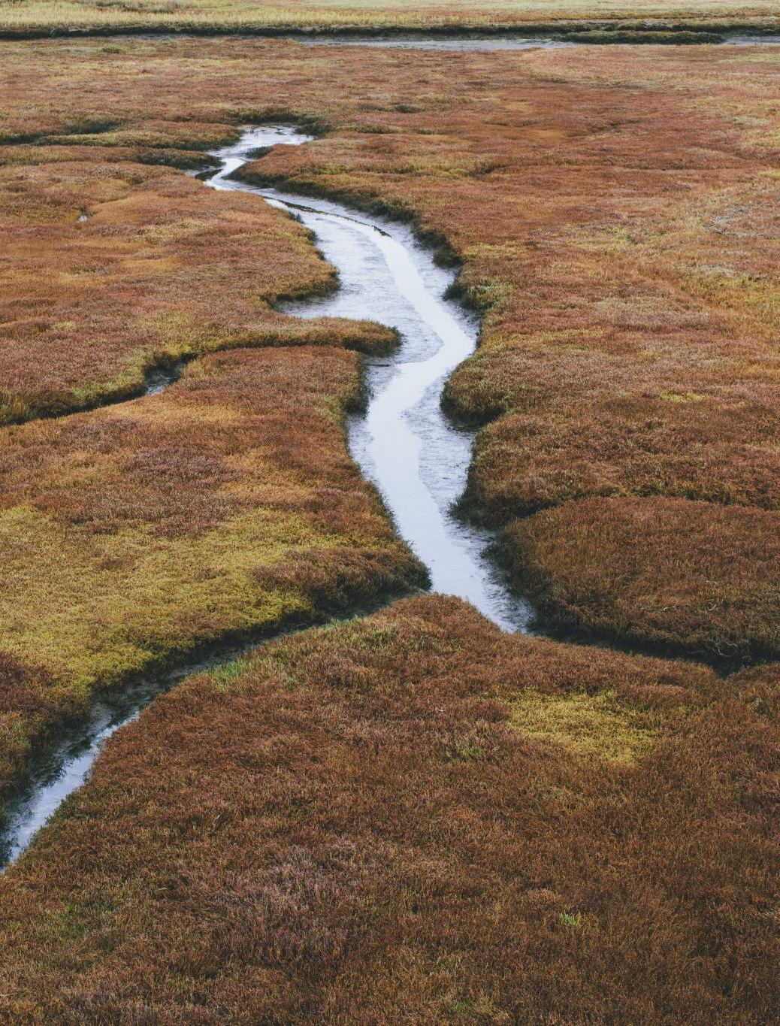
Capital assets

Slide 9
Cost & revenue analysis fy 23-24 - fy 28-29

Slide 10
Shoreline protection fund summary
 | Total Expenditures: | Adopted 07/01/2022 | Proposed | Difference from Current Year
720 | Beach | $ 2,980,484.00 | $ 3,178,204.00 | 6.63%
999 | Future Projects Fund | $ 1,168,779.00 | $ - | -100.00%
 |  |  |  |  | DIFFERENCE:
 |  | $ 4,149,263.00 | $ 3,178,204.00 | -23.40% | $(1,043,919.00)
 | Total Revenues: | $ 4,149,263.00 | $ 4,222,123.00 | 1.76%
Assuming current tax rate of $0.43 per hundred dollar valuation, with $0.10 assigned to the Shoreline Protection Fund.

Slide 11
Budget calendar
Budget Workshops
Workshop 2, Part 2: April 20, 2023
Workshop 3: May 10, 2023
Public Hearing on Budget
May 10, 2023
Budget / Ordinance Adoption
June 7, 2023

Slide 12
Thank you!

