Slide 1
North Topsail Beach ARPA Application Summary
April 5, 2023

Slide 2
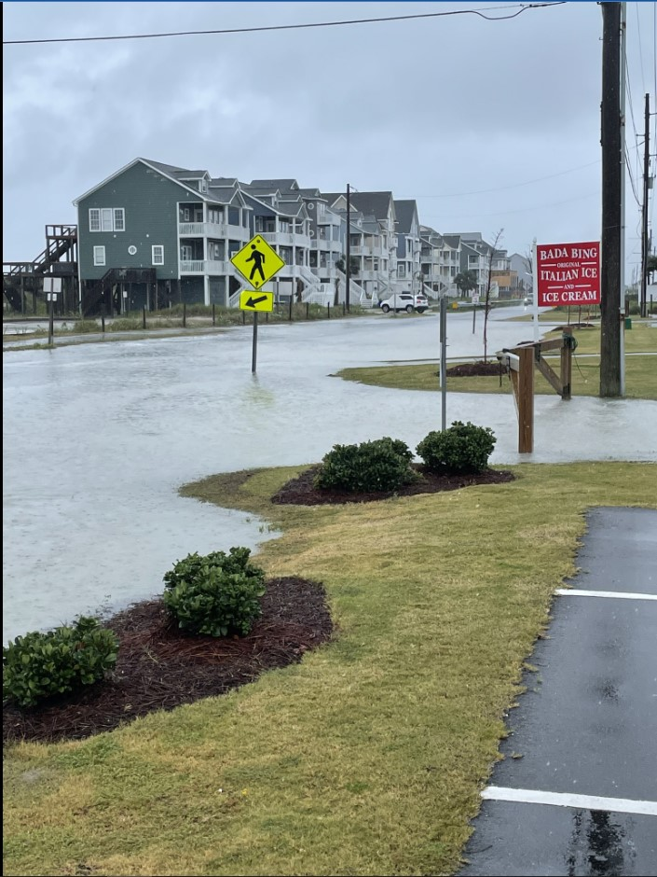
Background
Phase 1 and 2 of the Resilient Coastal Communities Program developed a project list for each Town.
3 Towns and the Community Action Team (CAT) unanimously approved these project sites for evaluation and implementation.
The presented solutions utilize nature-based designs, implement as little gray infrastructure as possible and are designed to infiltrate as much runoff as possible.

Slide 3
NCRCCP Phase 3 Grant
NCRCCP Objectives
Key Project Benefits
Natural/Nature-Based and Hybrid Solutions
Hazard Mitigation
Environmental Quality
Economic Prosperity
Provide additional storage off the road
Encourage infiltration to mitigate flooding

Slide 4
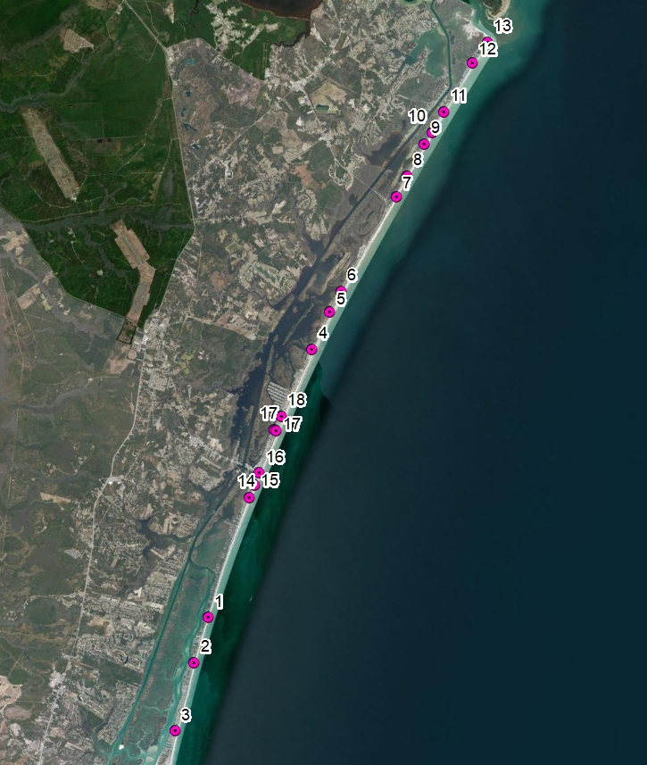
Project Overview
Municipalities
Town of North Topsail Beach,
Town of Surf City
Town of Topsail Beach
18 Hot Spot Sites
10 in North Topsail Beach
5 in Surf City
3 in Topsail Beach
North Carolina Resilient Coastal Communities Program (NCCRP) Phase 3
Consistent Standards
Prepare for Permitting and Implementation
Insert Map showing all 18 Hotspots
NCRCCP Phase 3 Sites – 18 Hotspots

Slide 5
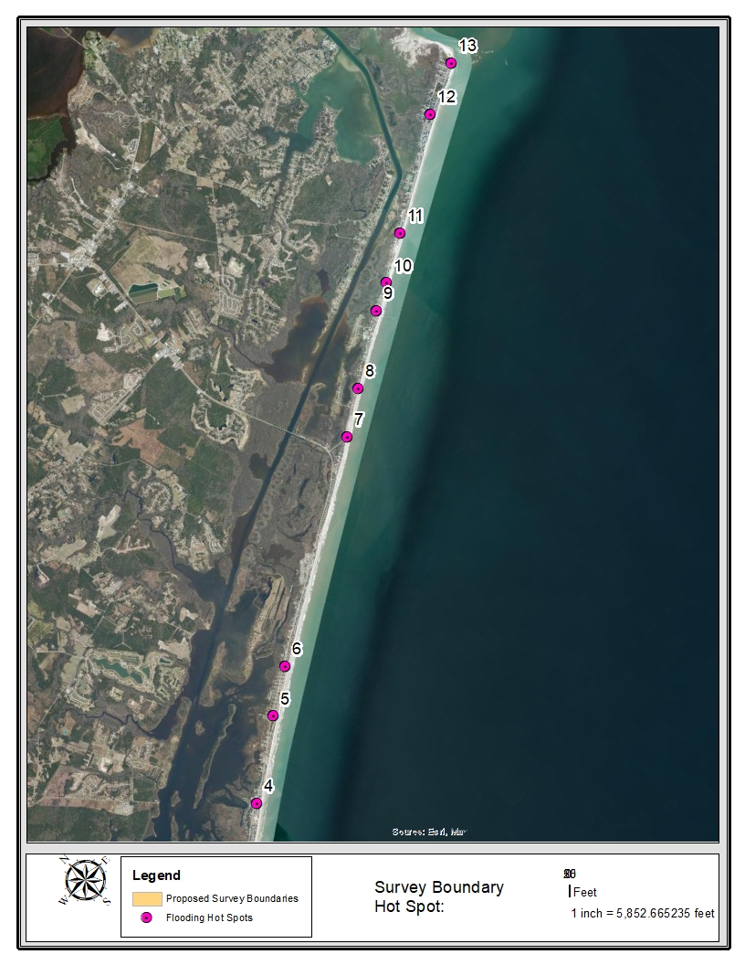
North Topsail Beach

Slide 6
Type of Infiltration Infrastructure

Slide 7
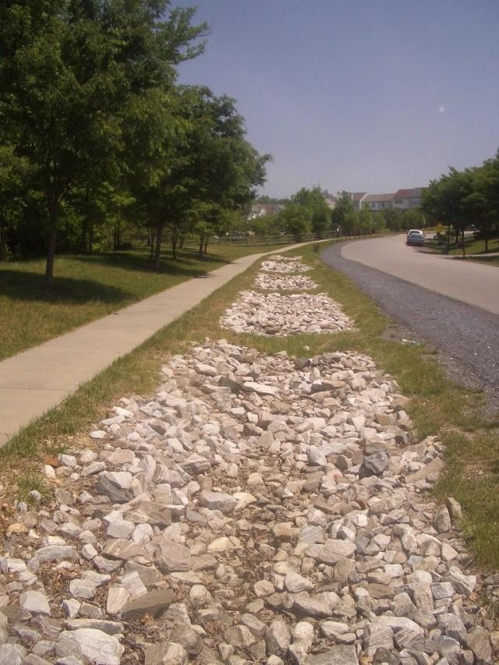
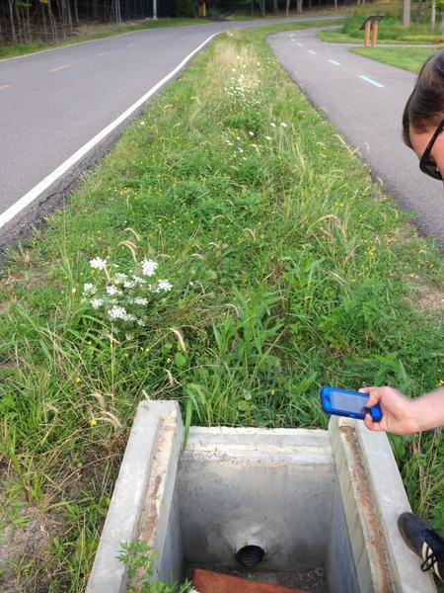
Infiltration Swale
Bioswale

Slide 8
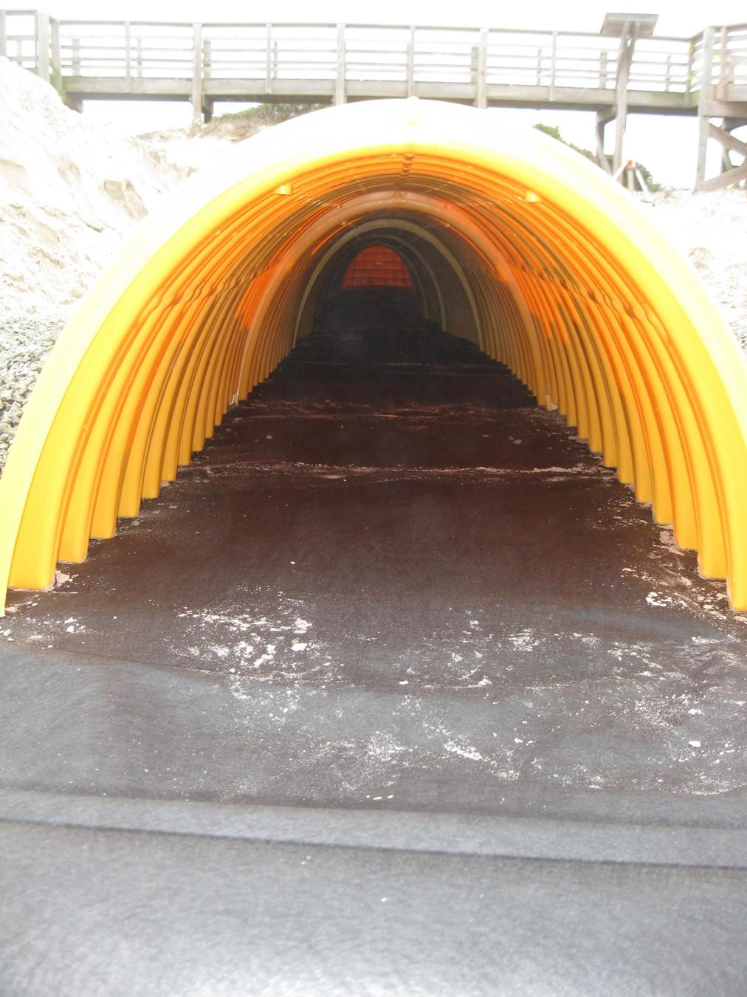
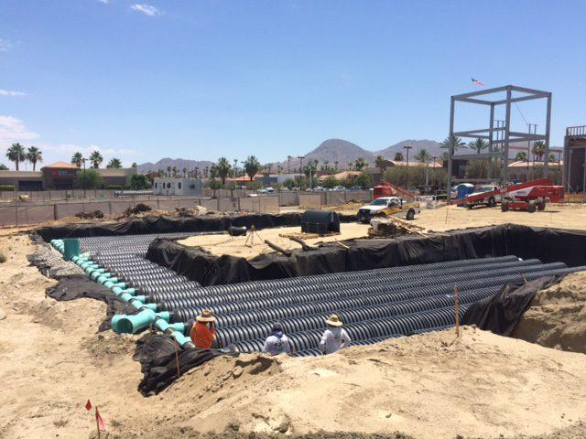
Infiltration Chamber

Slide 9
How it works
Infiltration System with pumps
Seasonally high-water table

Slide 10
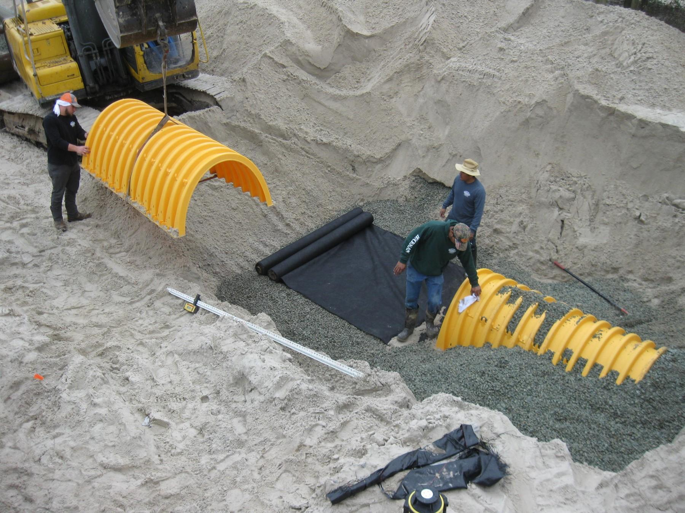
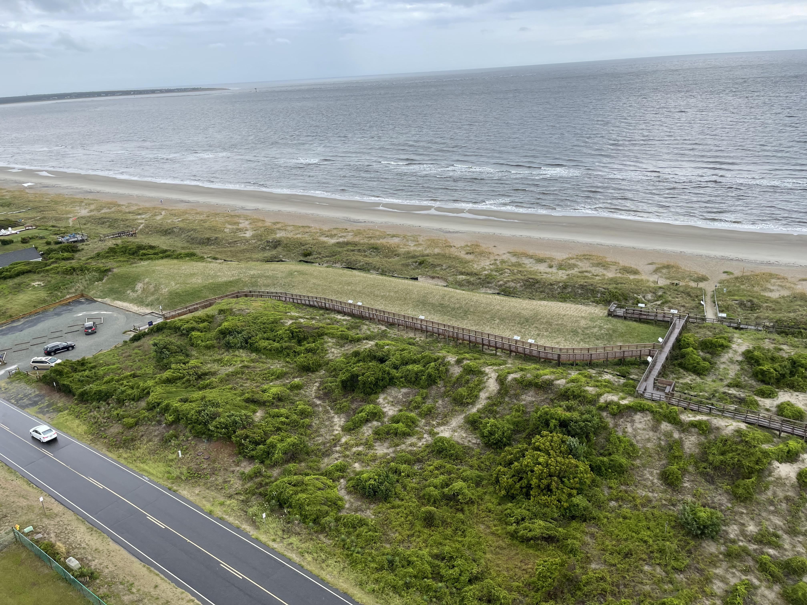
Dune Infiltration

Slide 11
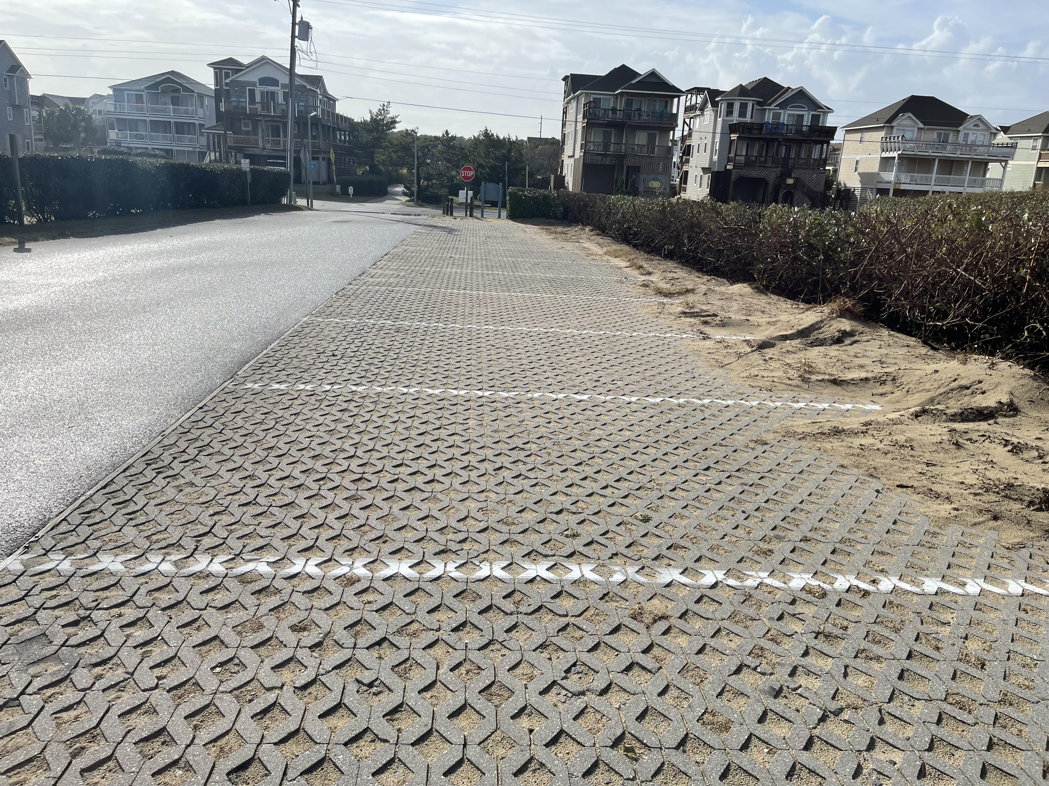
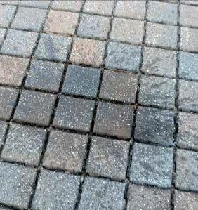
Permeable Pavers
Permeable Pavers – Standard parking Style
Permeable Pavers - Sidewalk and Street Style

Slide 12
ARPA LASII Funding

Slide 13
Local Assistance for Stormwater Infrastructure Investments Program (LASII)
Key Considerations
Funding Opportunities (Spring 2023)
Documentation of Stormwater Quantity or Quality Issues.
Demonstration of “Significant Hardship Raising the Revenue”.
Council Resolution
$6.3 Million allocated for Stormwater Planning Applications
No Matching Funds are Required
Application Due by May 1st, 2023.

Slide 14
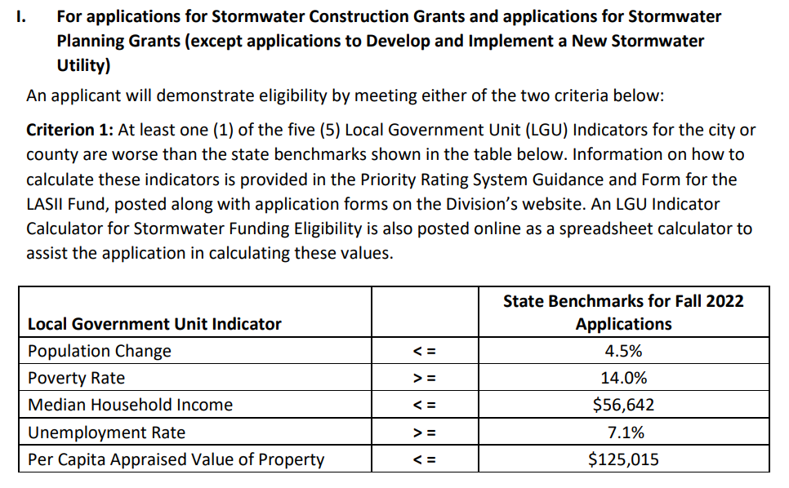
-23.10 %
$54,167

Slide 15
Hotspot solutions

Slide 16
Town of North Topsail Hotspots

Slide 17
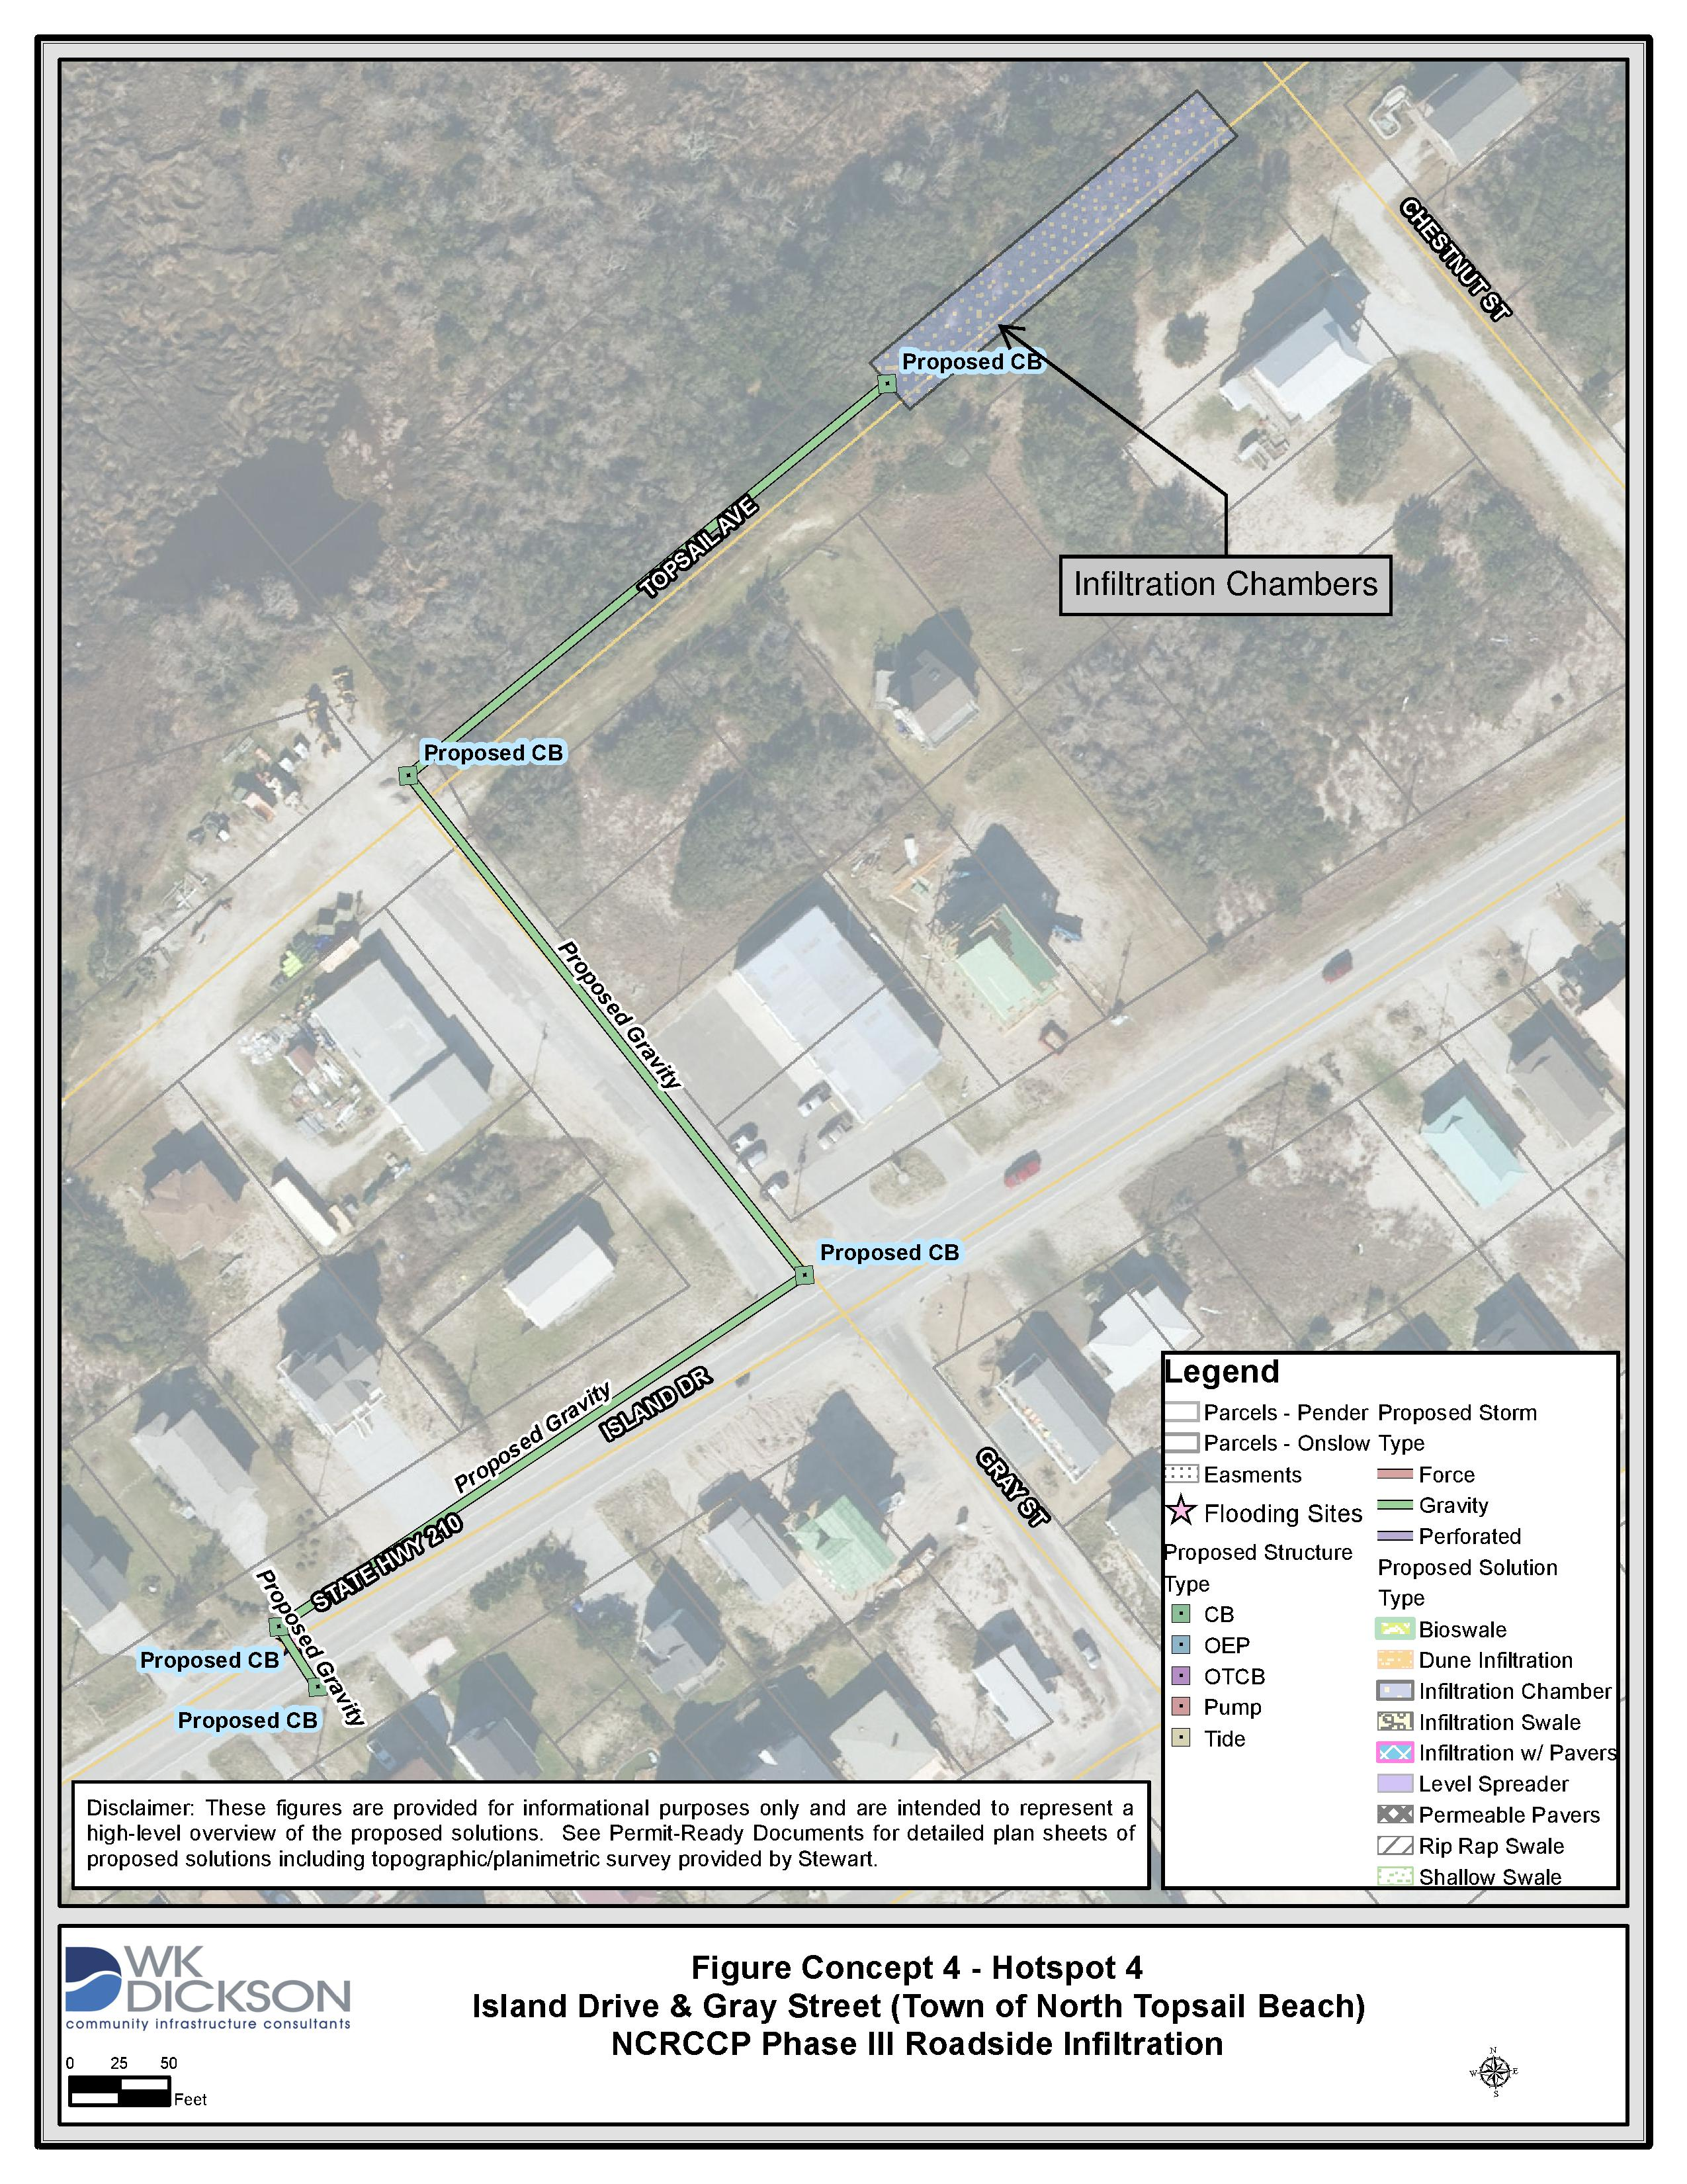
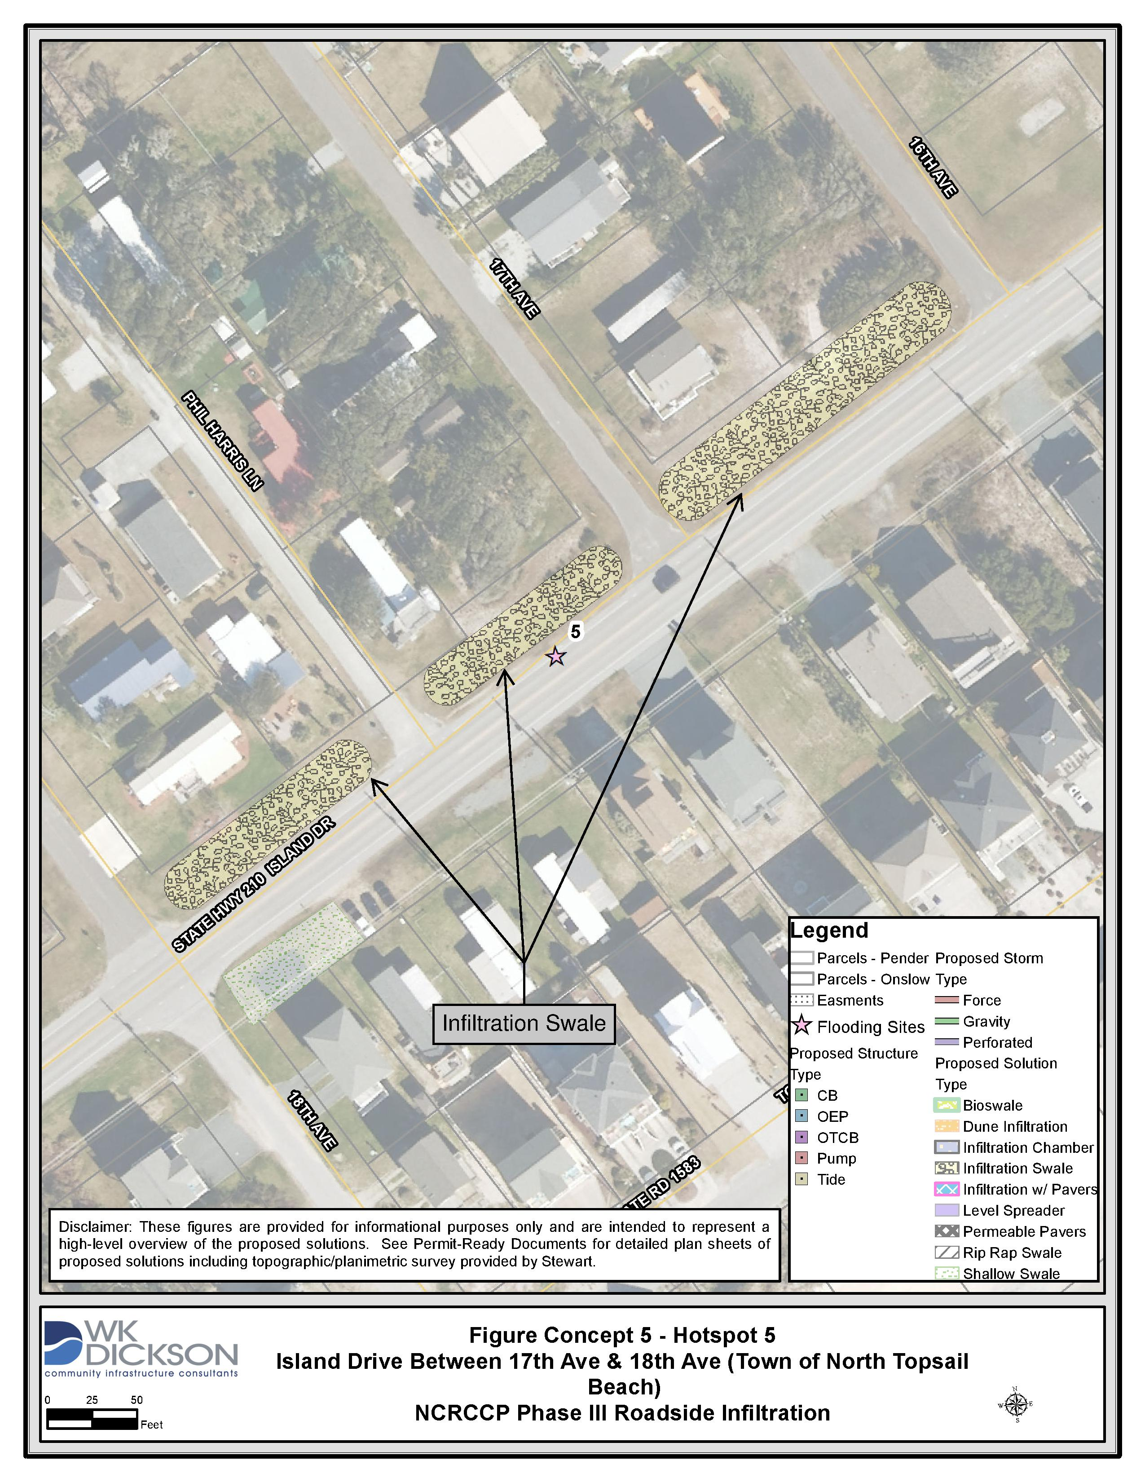
Hotspot 4
Hotspot 5

Slide 18
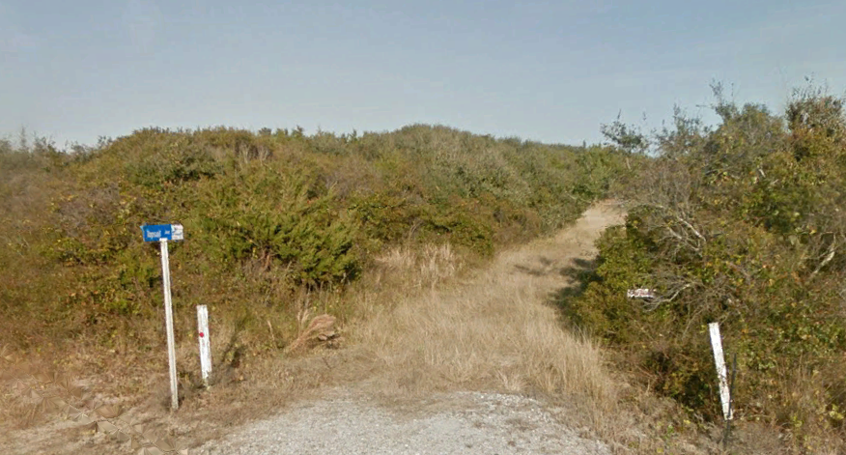
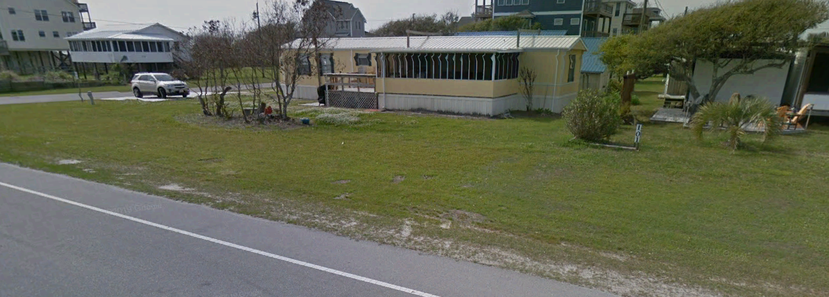
Hotspot 4- Infiltration Chambers
Hotspot 5- Infiltration Swales

Slide 19
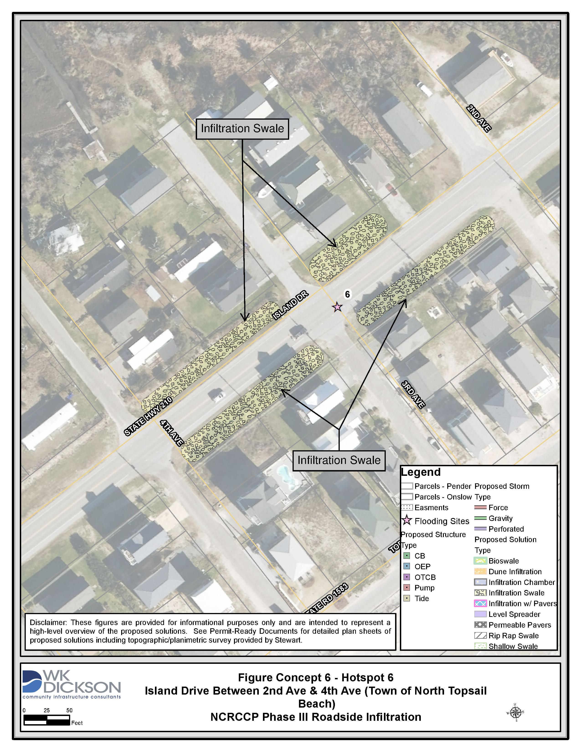
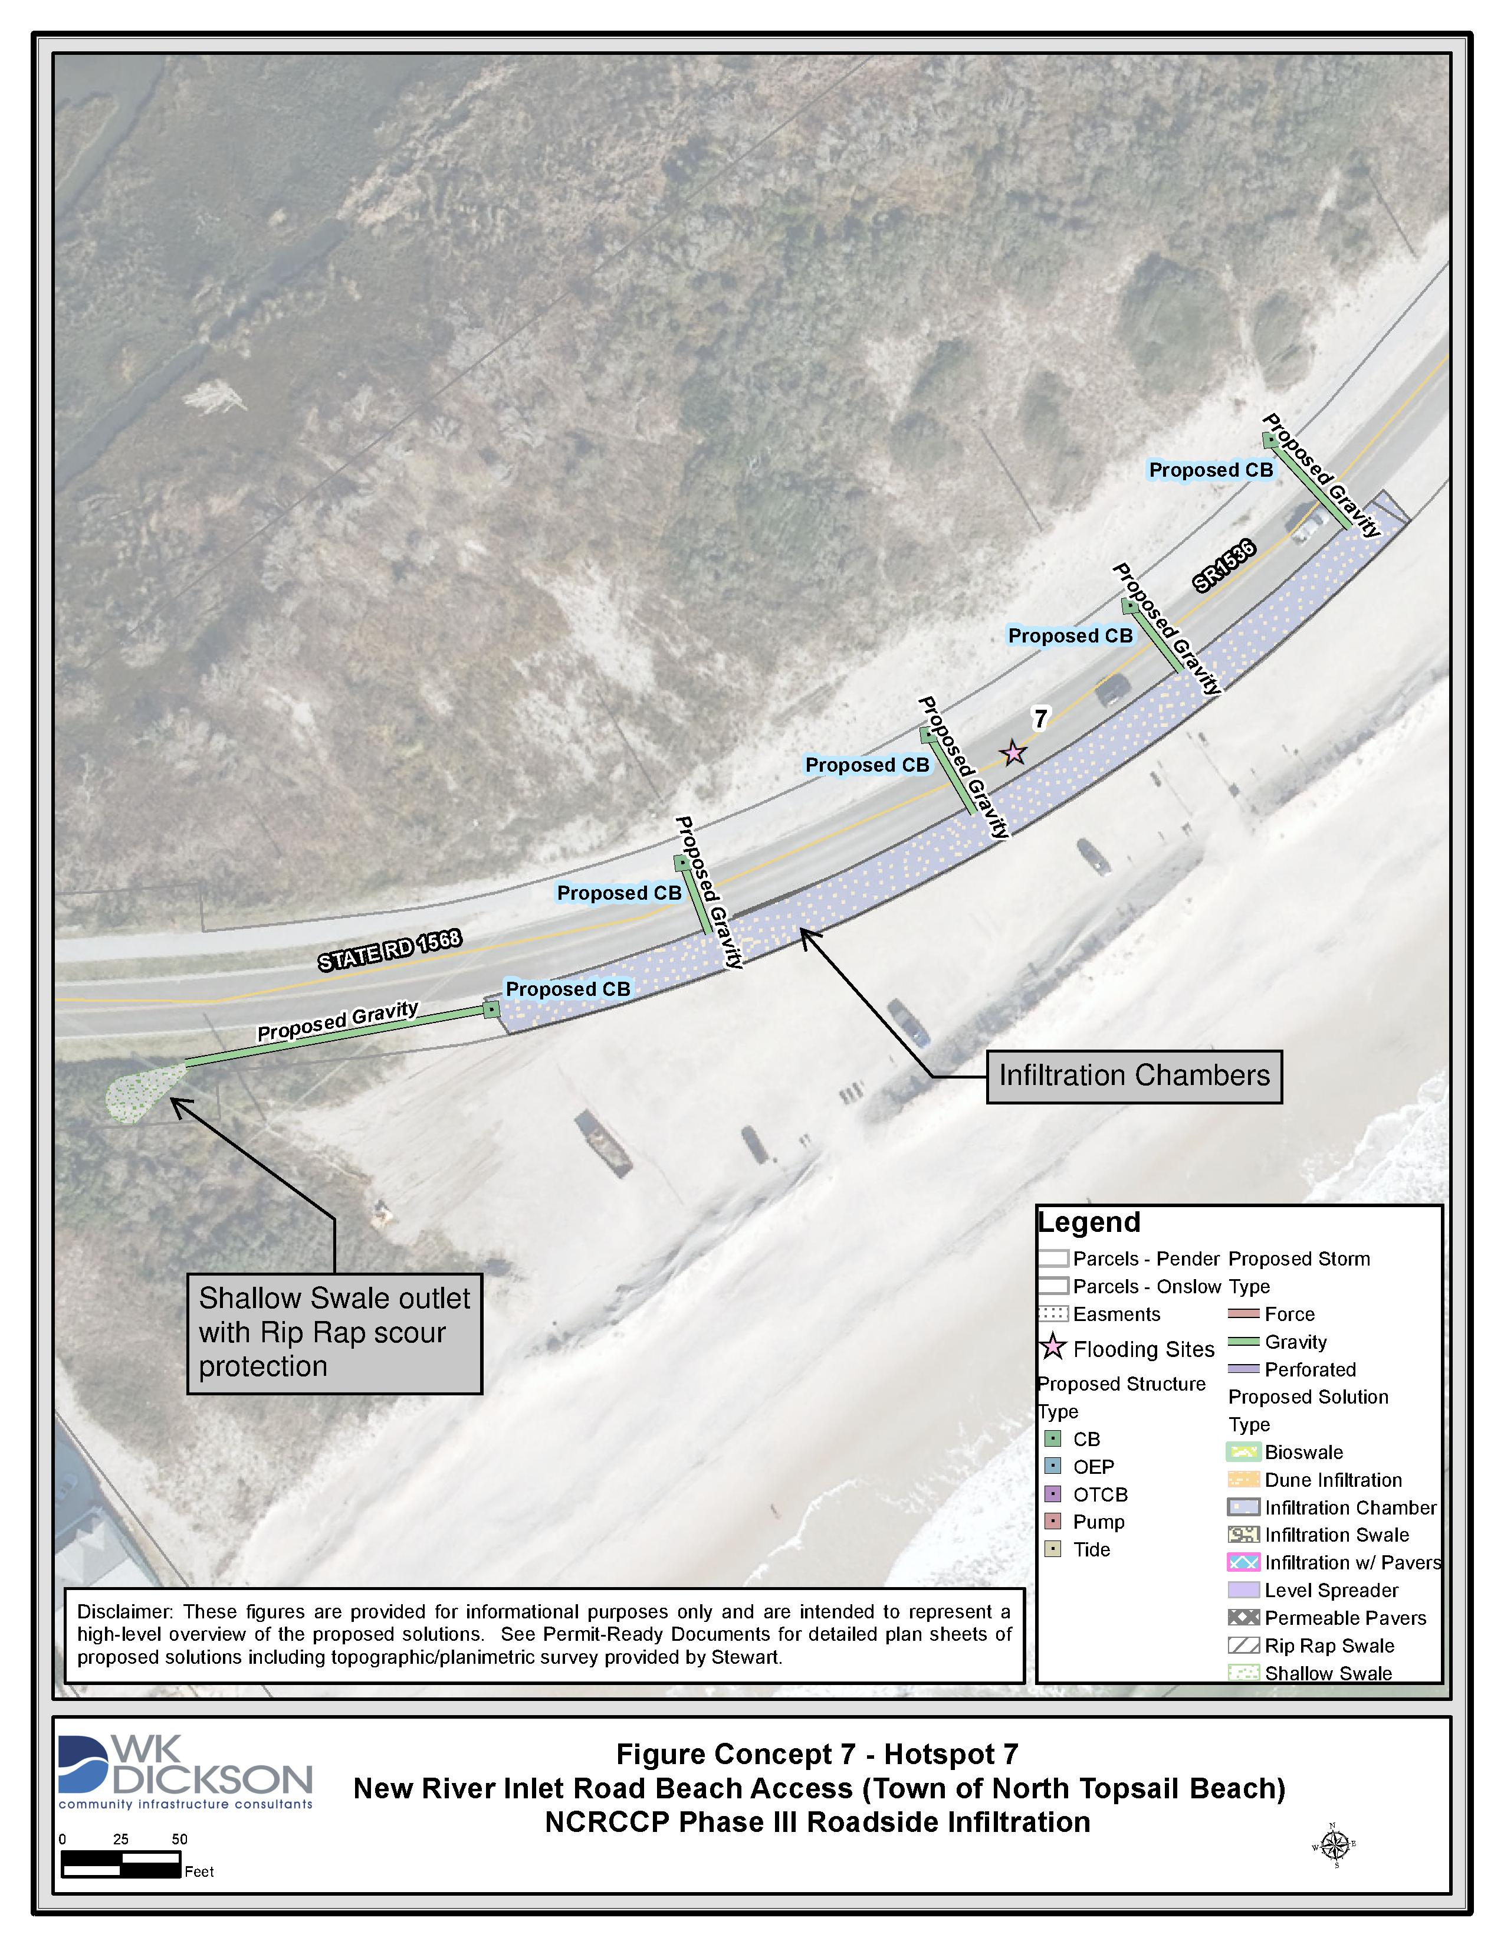
Hotspot 6
Hotspot 7

Slide 20
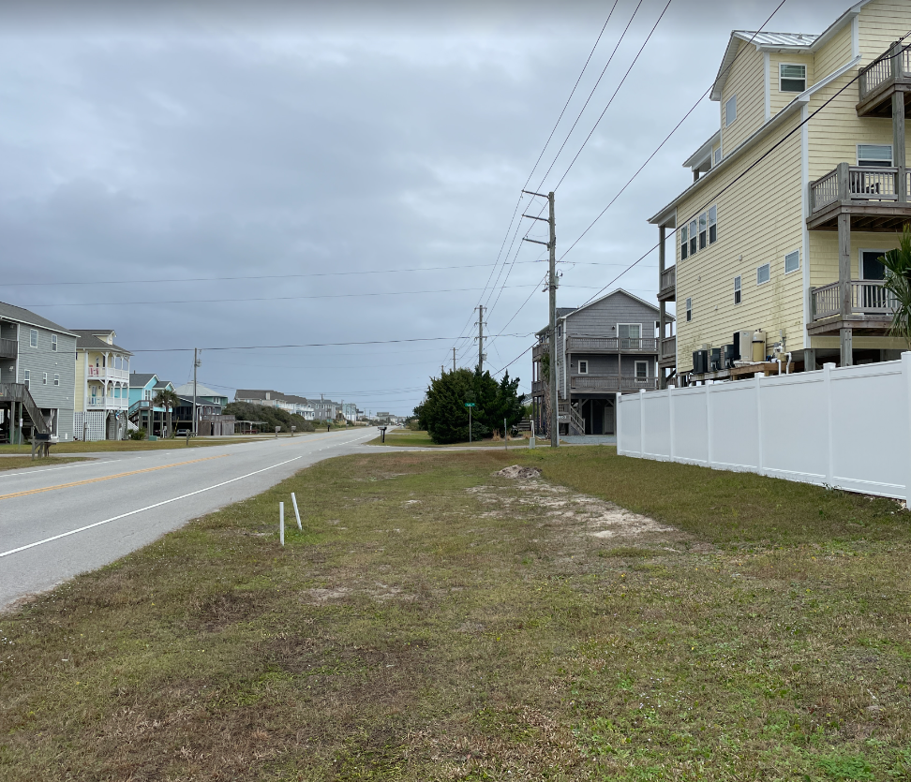
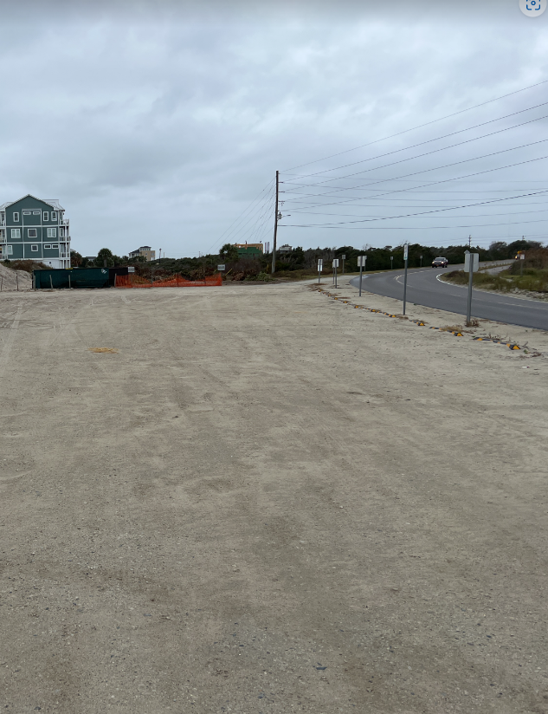
Hotspot 6- Infiltration Swale
Hotspot 7- Infiltration Chamber

Slide 21
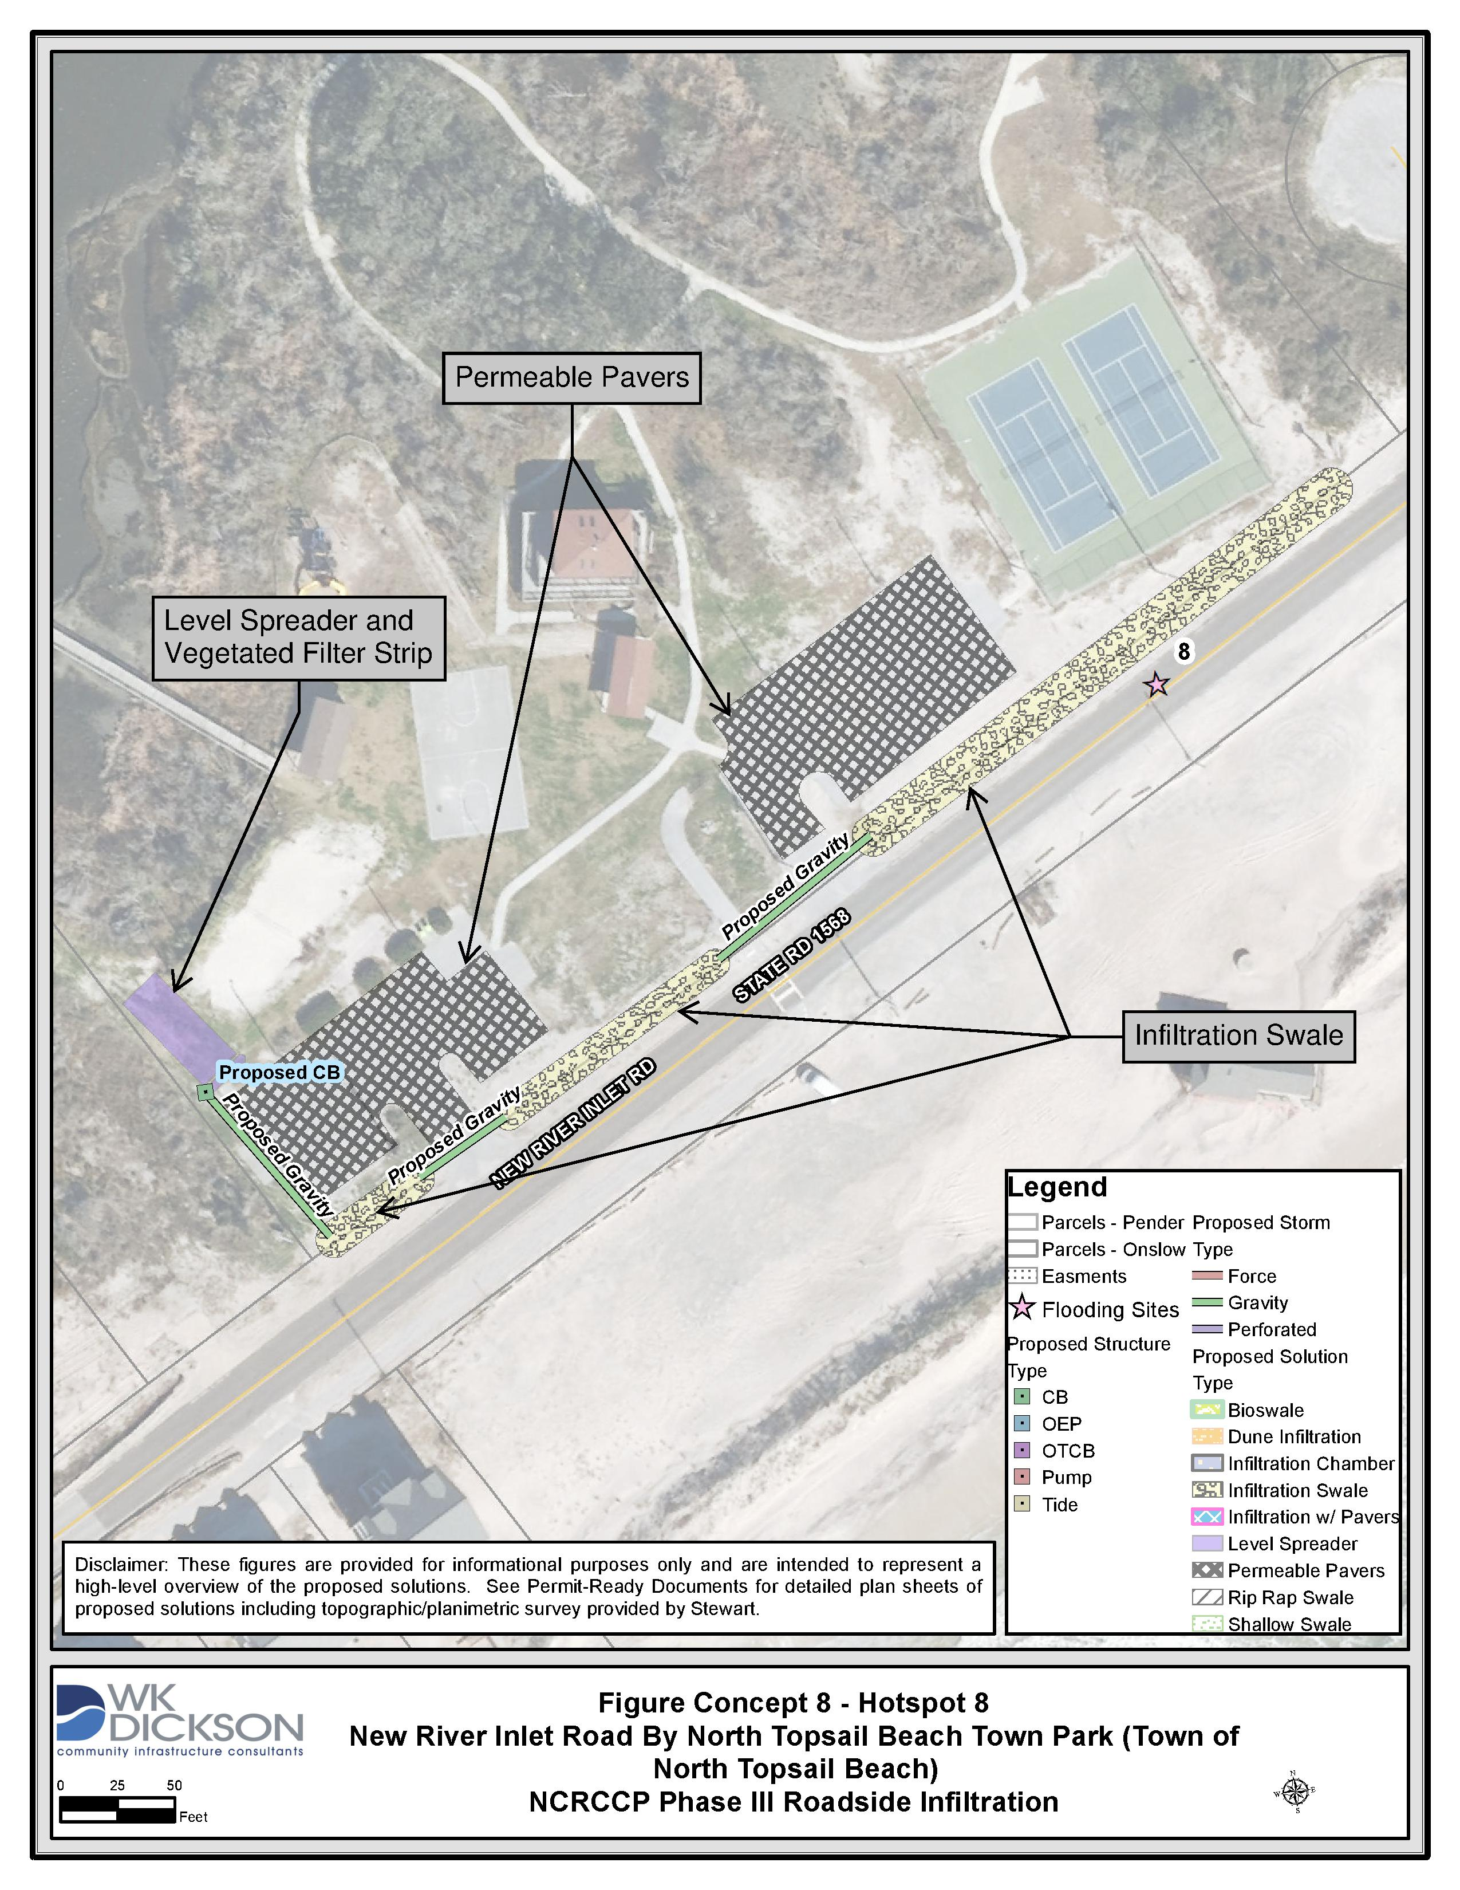
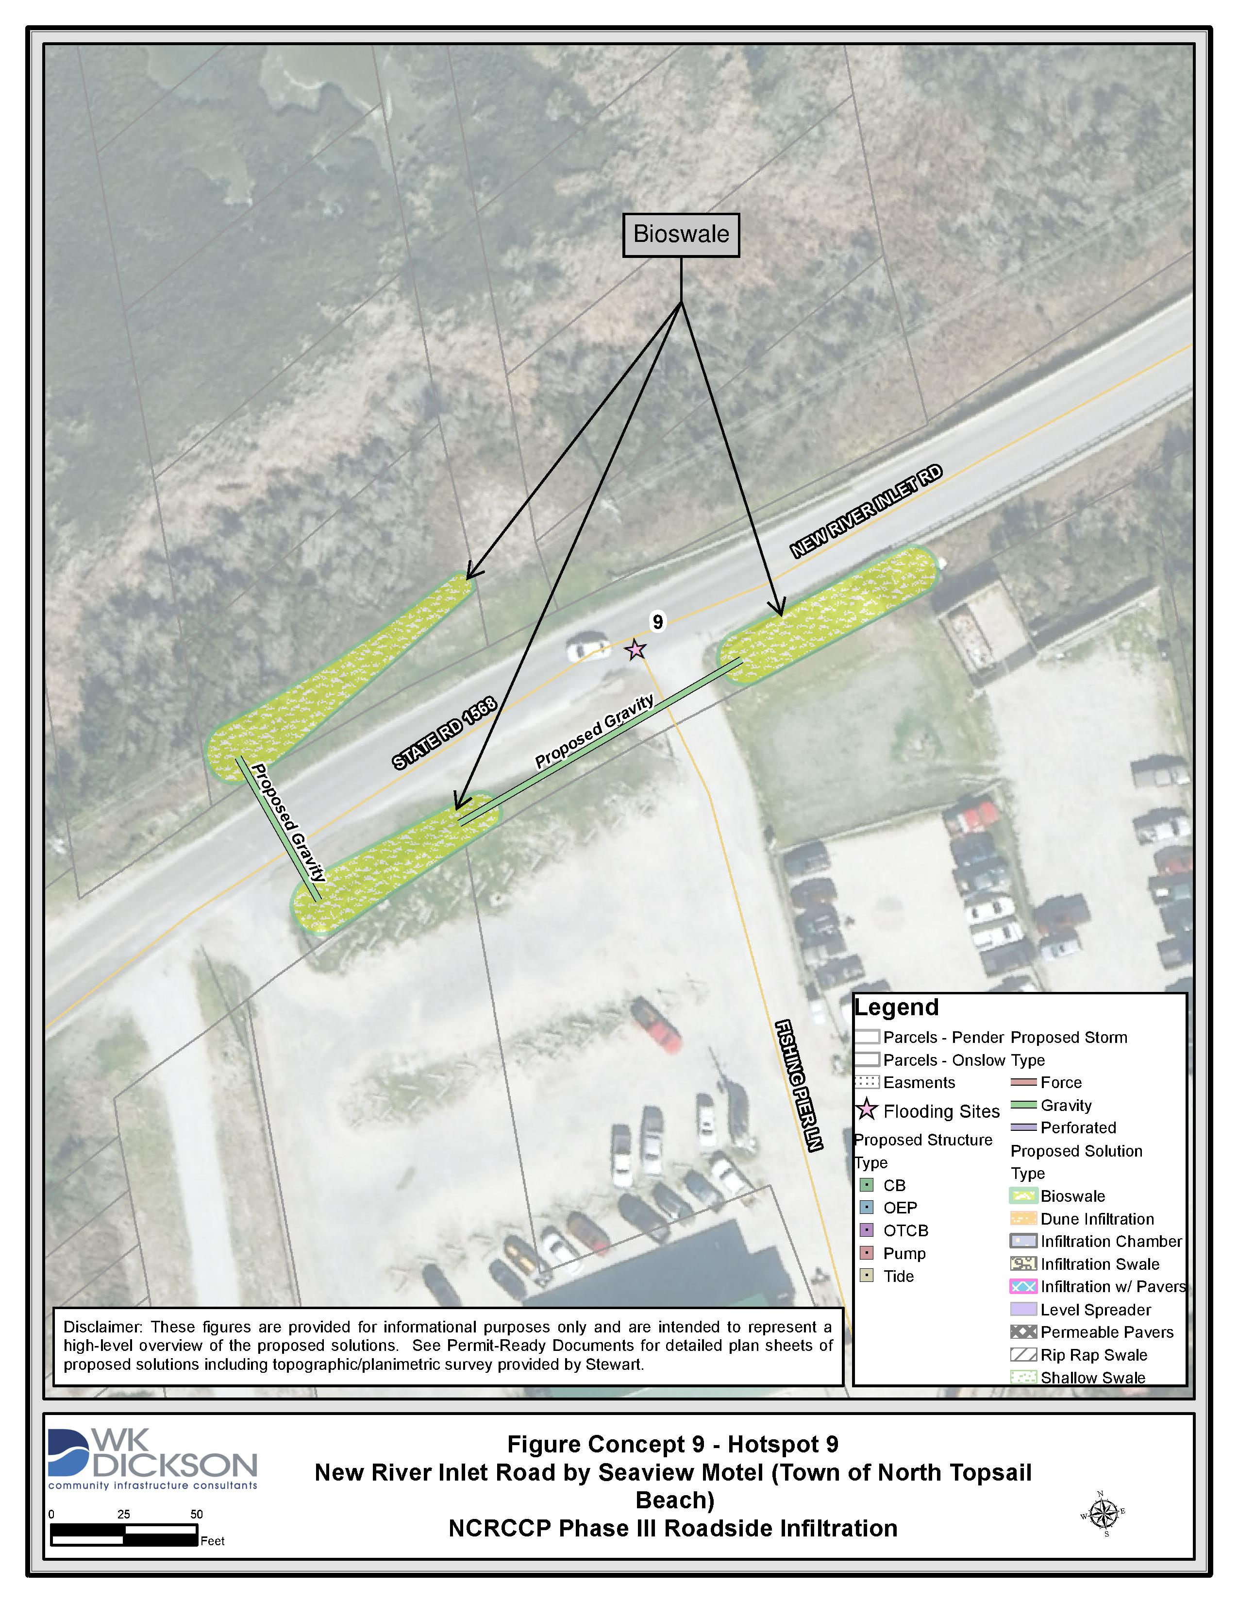
Hotspot 8
Hotspot 9

Slide 22
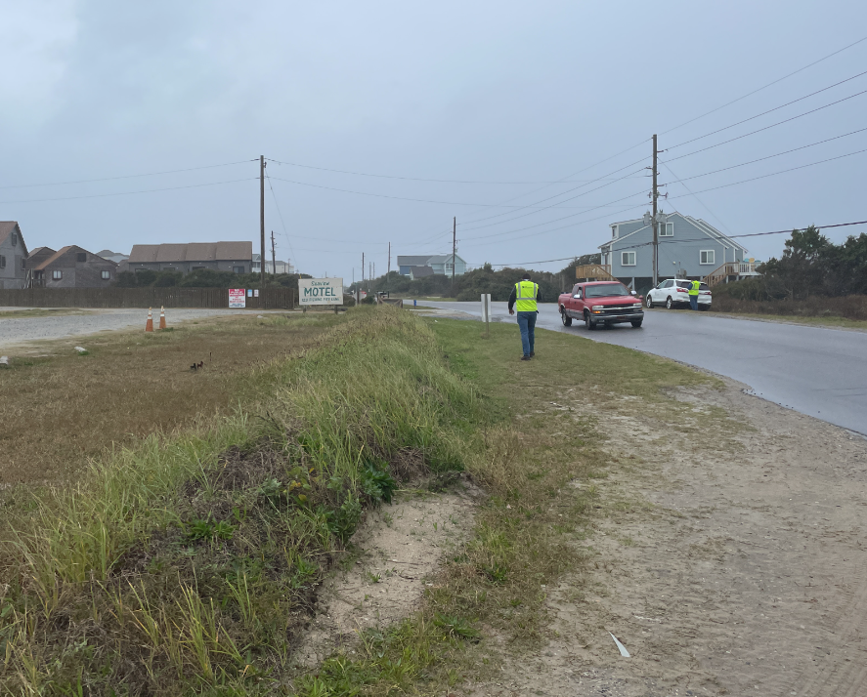
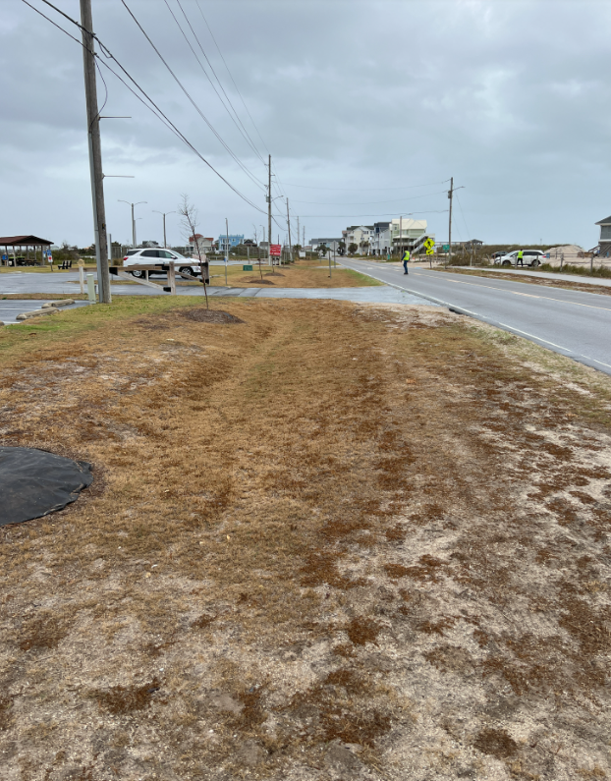
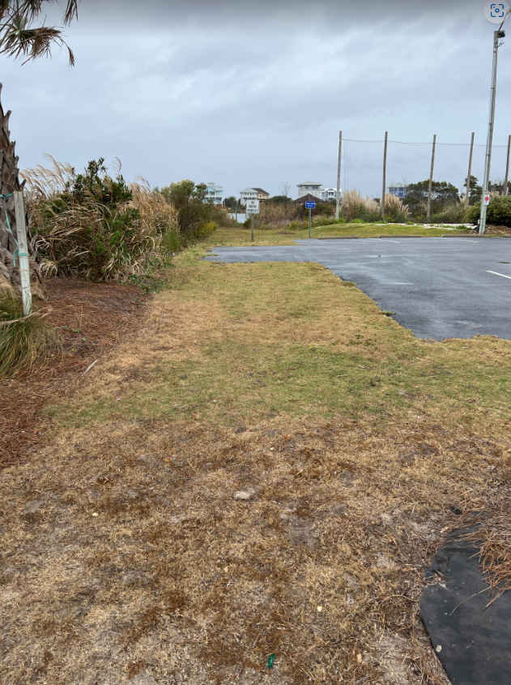
Hotspot 8
Hotspot 9- Bioswale
Pavers & Level Spreader
Infiltration Swale

Slide 23
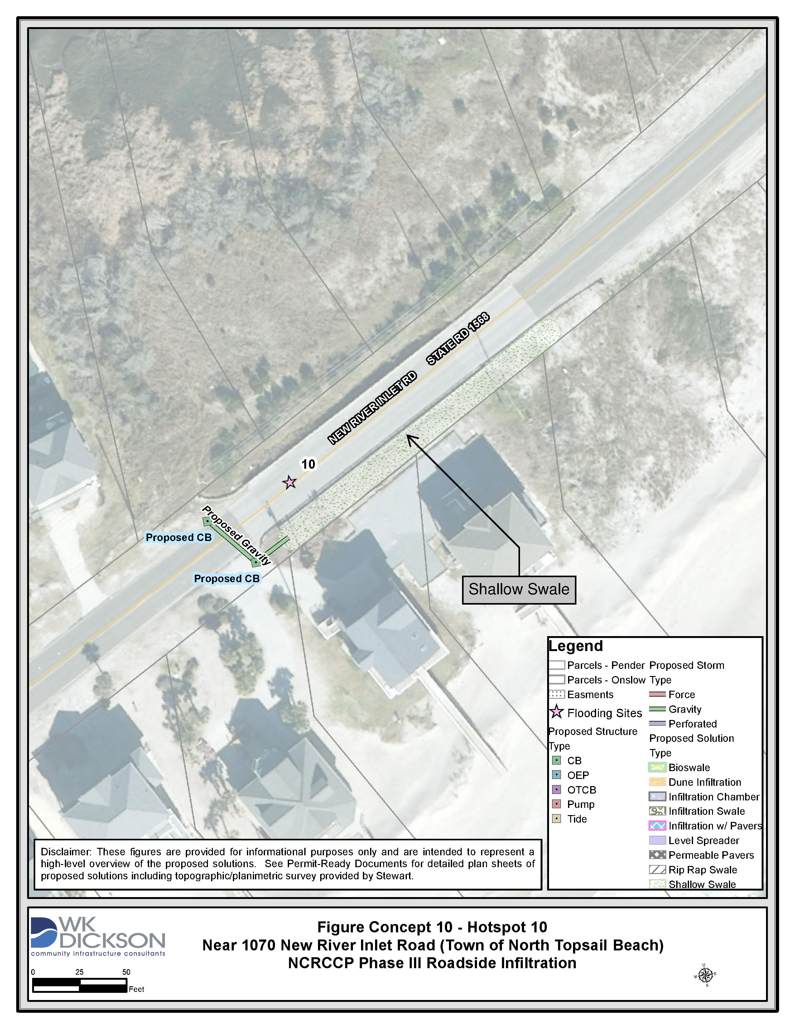
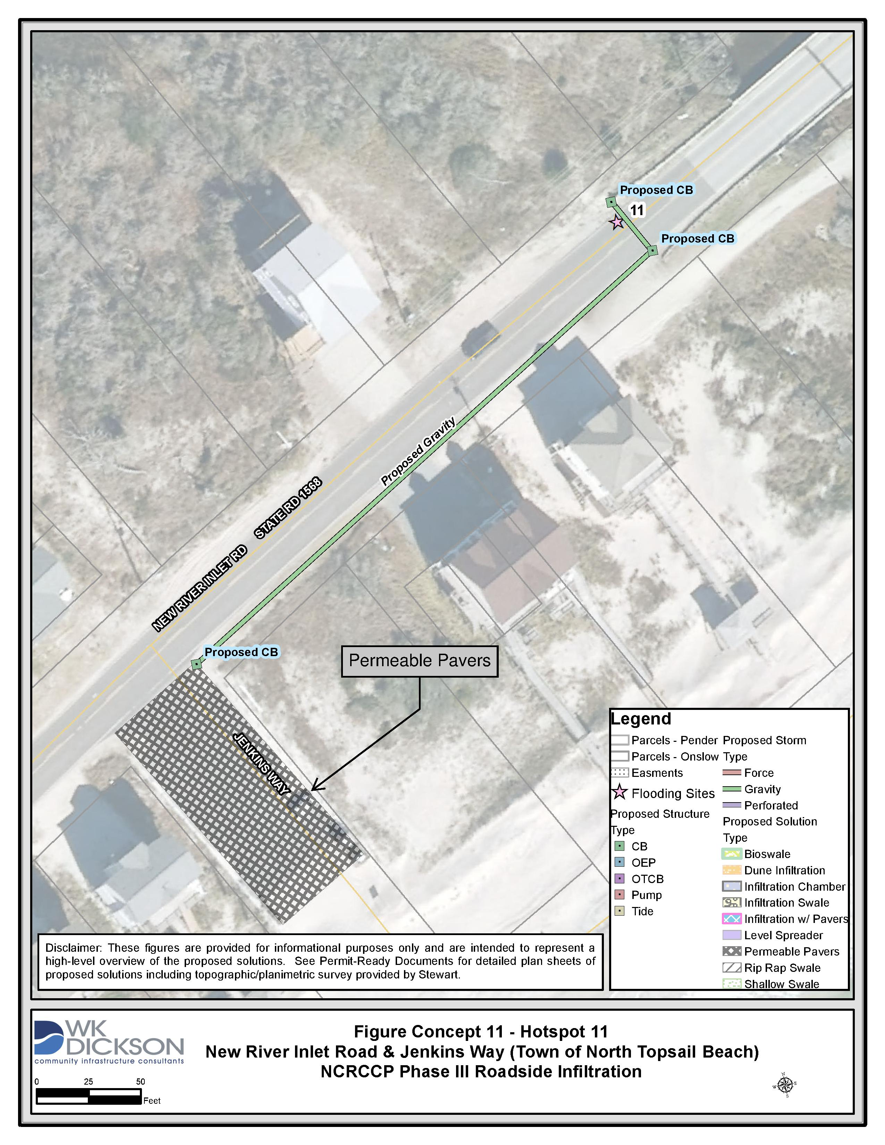
Hotspot 10
Hotspot 11

Slide 24
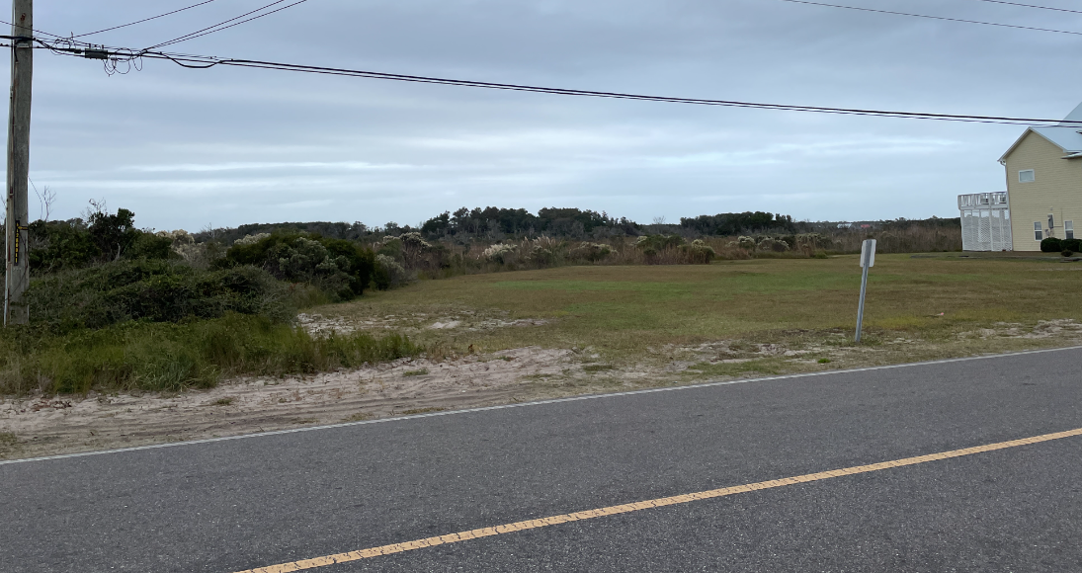
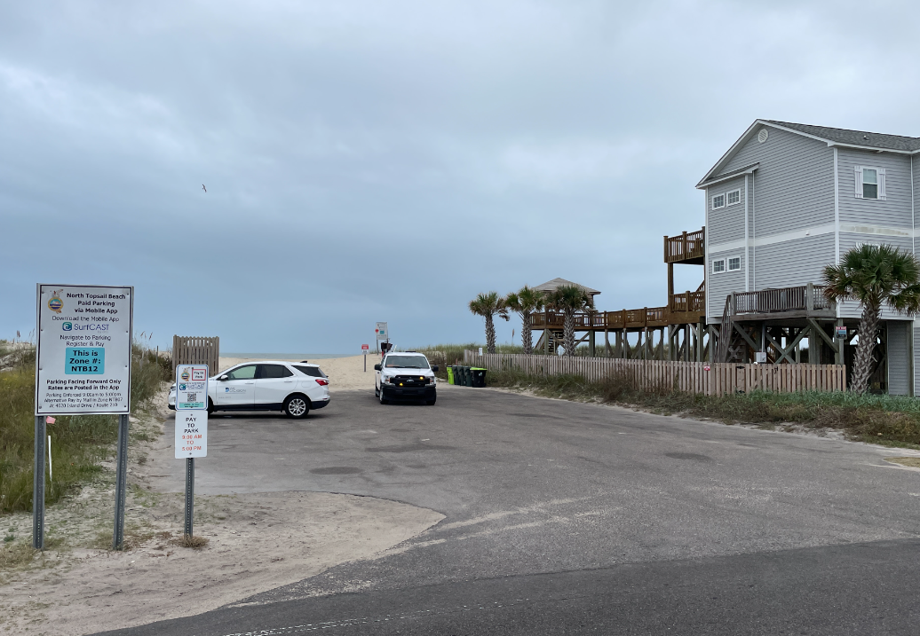
Hotspot 10 – Infiltration Swale
Hotspot 11- Permeable Pavers

Slide 25
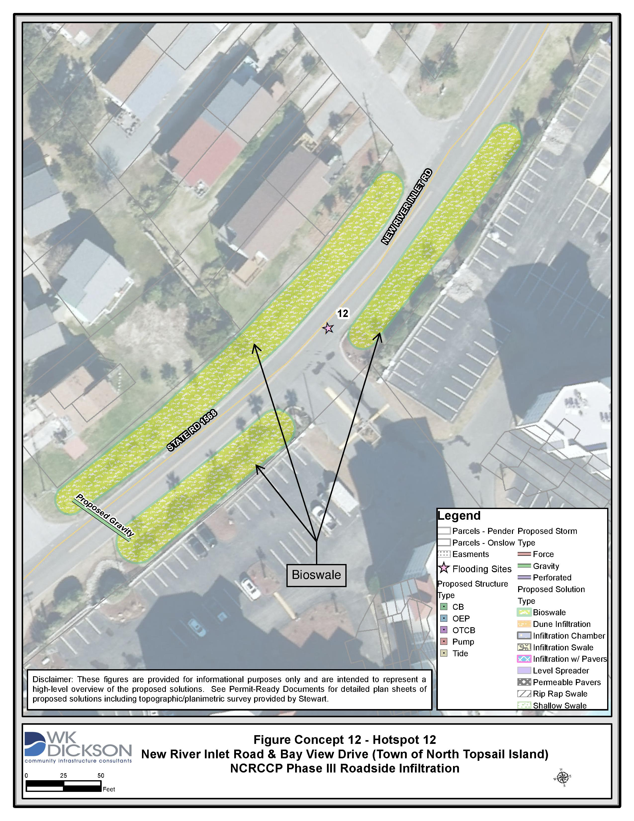
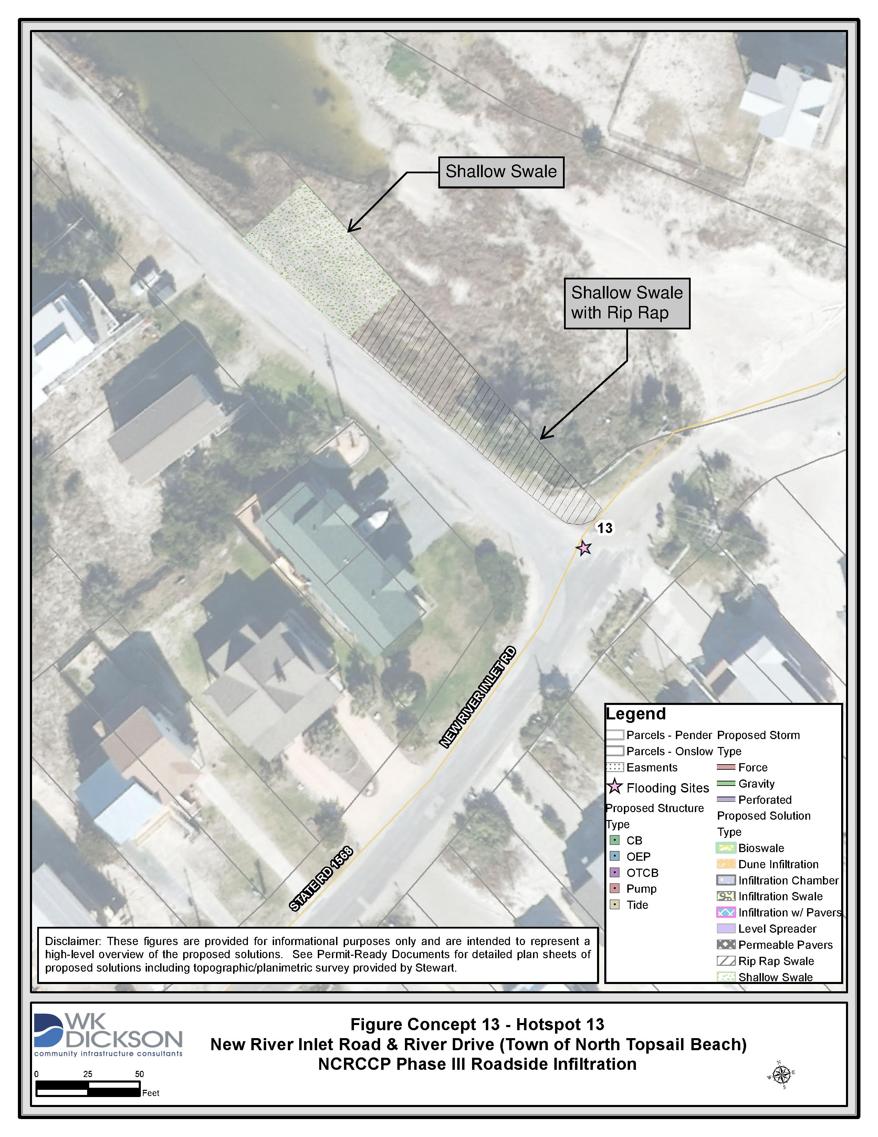
Hotspot 12
Hotspot 13

Slide 26
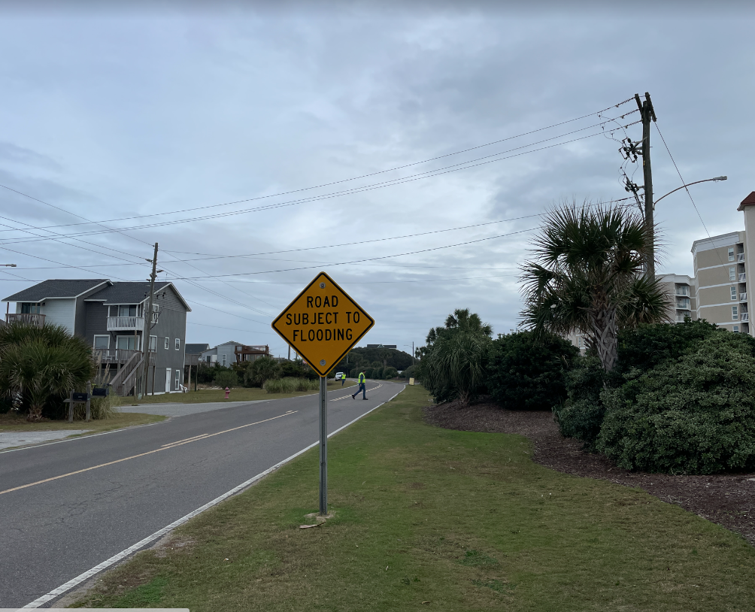
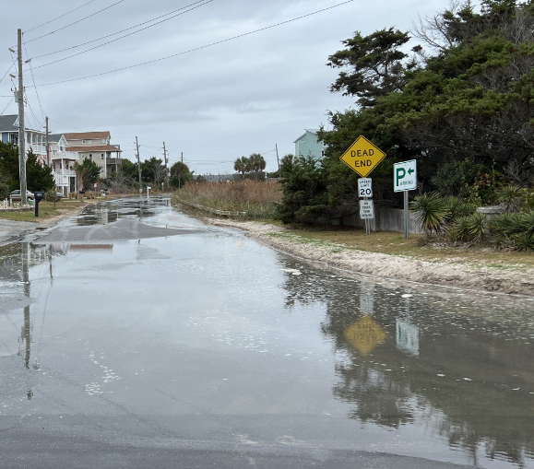
Hotspot 12 – Bioswale
Hotspot 13- Rip Rap Swale

Slide 27
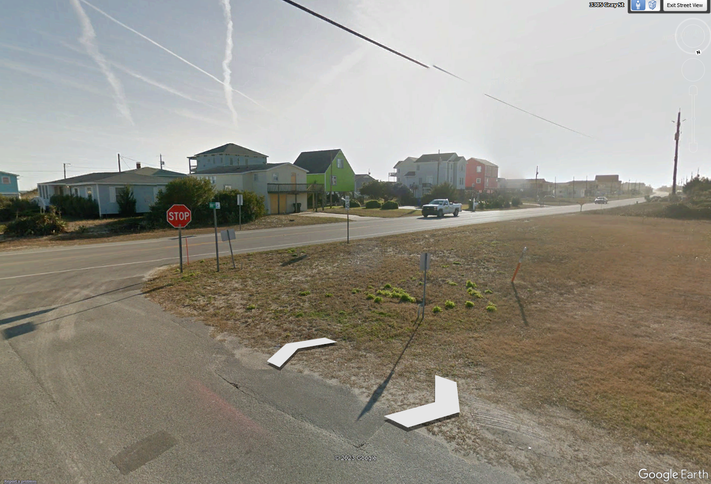
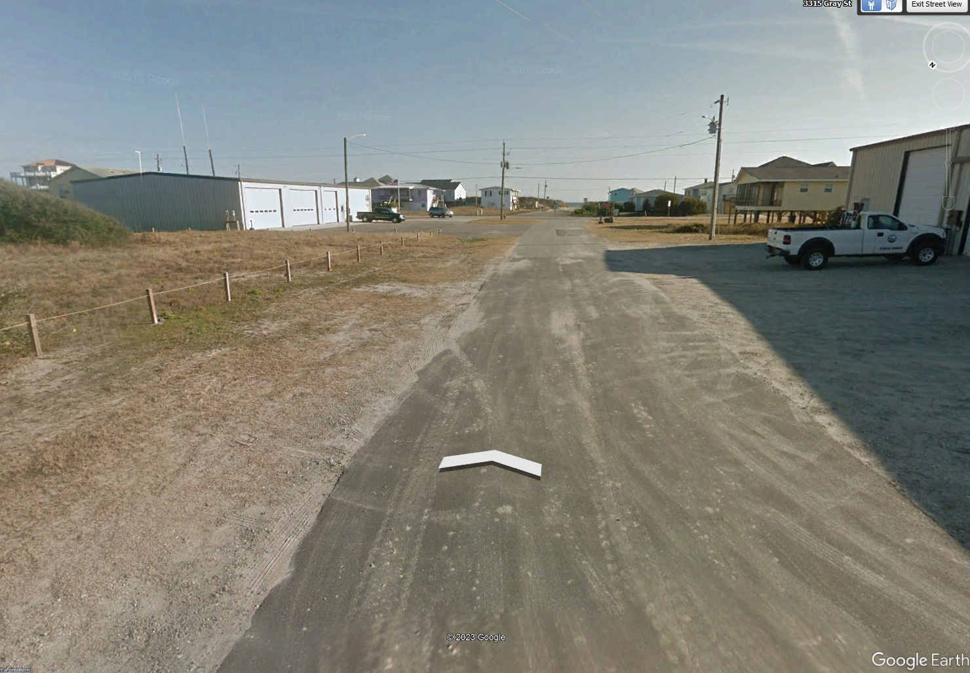
Hotspot 4

Slide 28
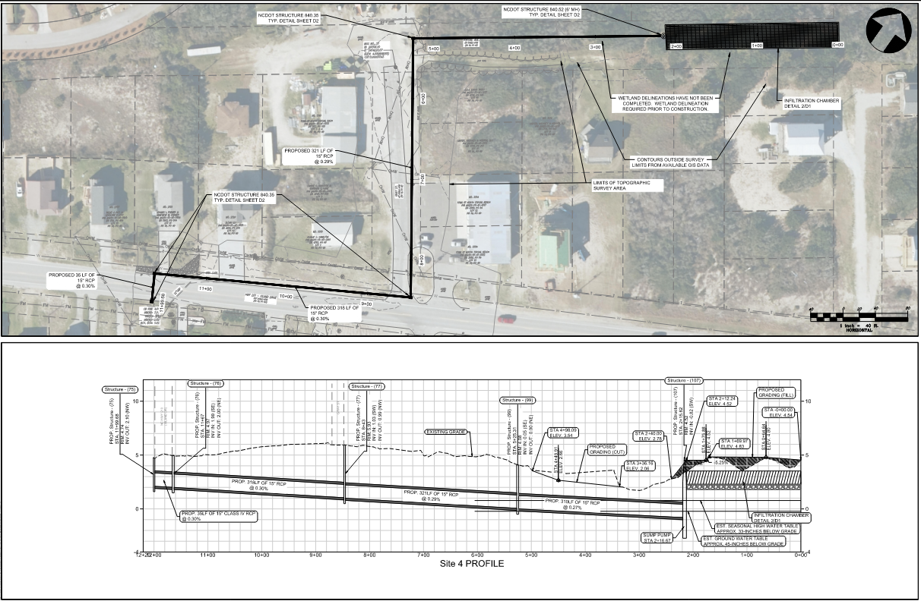

Slide 29
Estimated Construction Costs

Slide 30
Pavers & Level Spreader
Infiltration Swale

Slide 31
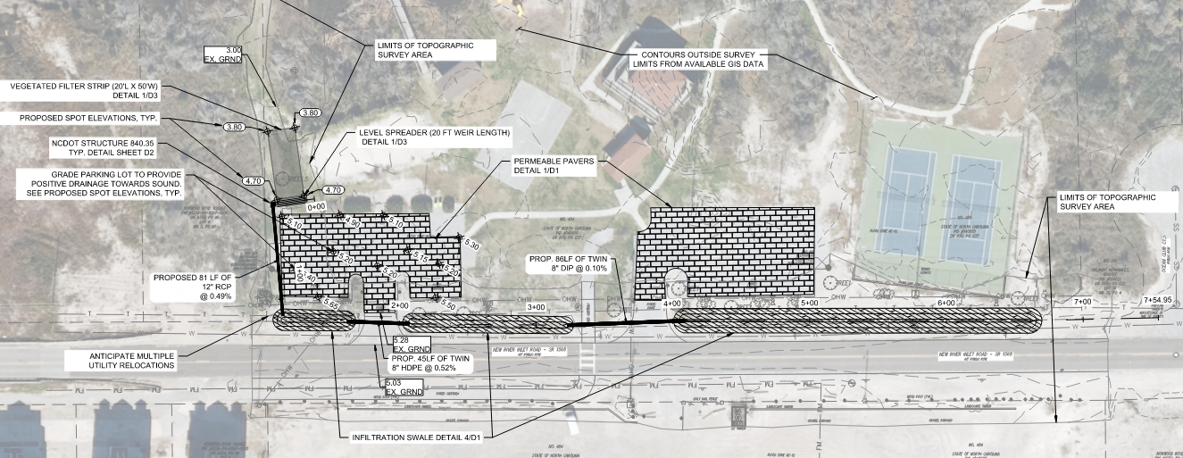

Slide 32
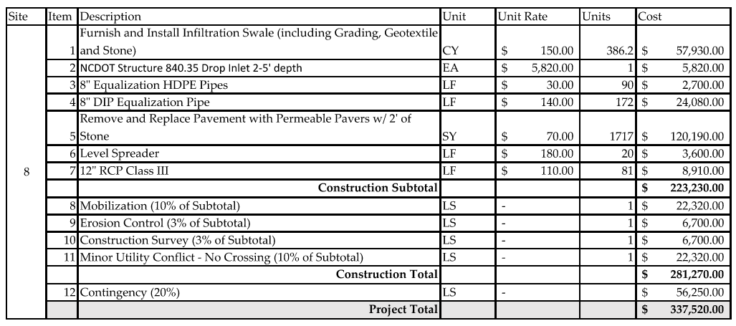
Estimated Construction Costs

Slide 33
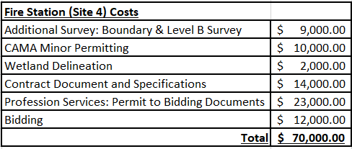
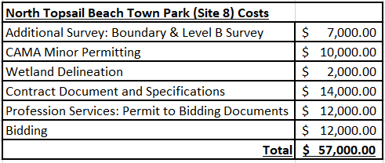
LASII Funding Request Recommendation

Slide 34
Questions?
Marc Horstman, PE, PH, D.WRE
Senior Project Manager
mhorstman@wkdickson.com
www.wkdickson.com

Slide 35
Investigation & Analysis

Slide 36
Project Approach
Key Considerations
Additional Considerations
Minimize Property Impact
ROW
Easements
Municipal Properties
Water Off the Road
Water Table
Soil Porosity
Municipality
NCDOT Standards
NCDEQ MDC’s
Bioswale, Infiltration Swale, Infiltration Chamber, Dune Infiltration & Permeable Pavers

Slide 37
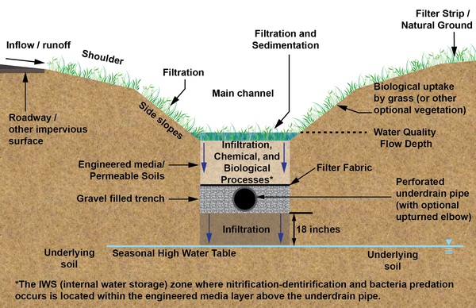
Infiltration Infrastructure
How It Works
Captures runoff from roadway
Provides additional storage
Infiltrates water into the sandy soils
Provides path for surface water to leave
Improves runoff Water Quality
Optional

Slide 38
Investigation
Field Investigation
Infiltration and Ground Water Testing
Survey and LiDar
Visited all 18 hotspots
Identified feasible solutions and surface potential challenges
Infiltration Testing
Seasonal High Water Table (SHWT)
Ground Water Table (GWT)
Survey
LiDar

Slide 39
Key Observations From Investigation
Field & Desktop Investigation
Infiltration and Ground Water Testing
Survey and LiDar
Limited available ROW, easement & Real Estate
Utilities occupy existing ROW
Limited active existing drainage infrastructure
SHWT and GWT depths vary significantly
Ground Water Table (GWT)
Elevation and available cover is minimum
Some sites will require wetland consideration

Slide 40
How it works
Dune Infiltration System with pumps
SHWT
Groundwater Table (GWT)

Slide 41
Hotspot Seasonal High Water Table (SHWT) and Groundwater Table (GWT) Depths
Hotspot # | Municipality | Site | SHWT Depth Ground to SWHT (Inches) | GWT Depth Ground to GWT (Inches)
Site 1a | Topsail Beach | N. Anderson & Sidbury Ave (Infiltration Chambers) | 130 | 143
Site 1b | Topsail Beach | N. Anderson & Sidbury Ave (Dune Infiltration) | 50 | 57
Site 2 | Topsail Beach | S. Anderson Blvd & Barwick Ave | 29 | 36
Site 3 | Topsail Beach | S. Anderson Blvd & Florida Ave | 33 | 45
Site 4 | N. Topsail Beach | Island Drive & Gray Street | 12 | 18
Site 5 | N. Topsail Beach | Island Drive Between 17th Ave & 18th Ave | 7 | 11
Site 6 | N. Topsail Beach | Island Drive Between 2nd Ave & 4th Ave | 50 | 63
Site 7 | N. Topsail Beach | New River Inlet Road Beach Access | 11 | 21
Site 8 | N. Topsail Beach | North Topsail Beach Town Park | 25 | 38
Site 9 | N. Topsail Beach | New River Inlet Road by Seaview Motel | 15 | 21
Site 10 | N. Topsail Beach | Near 1070 New River Inlet Rd | 15 | 23
Site 11 | N. Topsail Beach | New River Inlet Road & Jenkins Way | 27 | 36
Site 12 | N. Topsail Beach | New River Inlet Road & Bay View Drive | 5 | 12
Site 13 | N. Topsail Beach | New River Inlet Road & River Drive | 48 | 56
Site 14 | Surf City | S. Shore Road & Sea Horse Ave | 125 | 134
Site 15 | Surf City | S. Shore Road & Charlotte Ave | 168 | 173
Site 16 | Surf City | S. Shore Road & Roland Ave | 57 | 65
Site 17 | Surf City | N. New River Drive & Mecklenburg Ave | 18 | 24
Site 18 | Surf City | N. New River Drive & Pender Ave | 28 | 34
 |  | Minimum | 5 | 11
 |  | Average | 45 | 53
 |  | Maximum | 168 | 173

Slide 42
Infiltration Infrastructure Expected Performance
Above 1-2 ft of SHWT
Consistent infiltration entire year
Above 0-1 ft of SHWT
Peak infiltration in Spring & Summer
Reduced infiltration in Fall & Winter
Below 0-0.5 ft of SHWT
Some infiltration during Spring & Summer
Min. infiltration during Fall & Winter
Below 0.5-2.0 ft of SHWT
Primarily acts as storage
Some infiltration Spring & Summer
Very little infiltration during Fall & Spring

Slide 43
Hotspot & SHWT Summary
HotSpots with Infiltration Structure 1-2 ft above SHWT
Hotspot # | Municipality | Description
Site 1b | Town of Topsail Beach | S. Anderson & Sidbury Ave (Dune Infiltration)
Site 15 | Town of Surf City | S. Shore Road & Charlotte Ave
Site 16 | Town of Surf City | S. Shore Road & Roland Ave
Site 17 | Town of Surf City | N. New River Drive & Mecklenburg Ave
Site 4 | Town of North Topsail beach | Island Drive & Gray Street
Site 13 | Town of North Topsail beach | New River Inlet Road & River Drive
Hotspots with Infiltration Structure 0-1 ft SHWT
Hotspot # | Municipality | Description
Site 18 | Town of Surf City | N. New River Drive & Pender Ave
Site 7 | Town of North Topsail beach | New River Inlet Road Beach Access
Site 9 | Town of North Topsail beach | New River Inlet Road by Seaview Motel
Site 10 | Town of North Topsail beach | Near 1070 New River Inlet Rd
Site 12 | Town of North Topsail beach | New River Inlet Road & Bay View Drive
Site 14 | Town of North Topsail beach | S. Shore Road & Sea Horse Ave
Hotspots with Infiltration Structure 0-0.5 ft below SHWT
Hotspot # | Municipality | Description
Site 2 | Town of Topsail beach | S. Anderson Blvd & Barwick Ave
Site 5 | Town of North Topsail beach | Island Drive Between 17th Ave & 18th Ave
Hotspot with Infiltration Structure 0.5-2 ft below SHWT
Hotspot # | Municipality | Description
Site 1a | Town of Topsail beach | S. Anderson & Sidbury Ave (Infiltration Chambers)
Site 3 | Town of Topsail beach | S. Anderson Blvd & Florida Ave
Site 6 | Town of North Topsail beach | Island Drive Between 2nd Ave & 4th Ave
Site 8 | Town of North Topsail beach | North Topsail Beach Town Park
Site 11 | Town of North Topsail beach | New River Inlet Road & Jenkins Way

