Slide 1






5 YEAR & 30 YEAR PLAN
THE EARLY YEARS
North Topsail Beach Board of Aldermen
7 February 2024

Slide 2
REACH 1
FY 26
REACH 2
FY 26
REACH 3
FY 26
REACH 4
FY 25
REACH 5
FY 24
Beach Reaches

Slide 3
Plan Goals
Provide Nourishment and Shoreline Stabilization Townwide Within 5 Years
Have Entire Town Meet “Engineered Beach” Criteria For FEMA
Make As Many Properties CAMA Setback Conforming As Possible
Implement Long Term (30 Year) Plan with Appropriate Funding Resources
Implement Proactive Construction/Beach Management Practices
MAINTAIN A FISCALLY RESPONSIBLE PROGRAM

Slide 4
REACH 1
REACH 1: 9,000 ft
450,000 cy
REACH 2: 10,120 ft
760,000 cy
REACH 2

Slide 5
REACH 2
REACH 3
REACH 4
REACH 3: 6,880 ft
525,000 cy
REACH 4: 11,500 ft
350,000 cy
REACH 5

Slide 7
Borrow Area DA143
Approximately 1.9 Million CY
Relatively Easy to Permit
Less Expensive to Use than Offshore Borrow
Sufficient for Reaches 1, 2 & 3 plus
Eligible for Shallow Draft Fund
$5M USACE study on 6 DA rehabs Includes DA 143

Slide 8
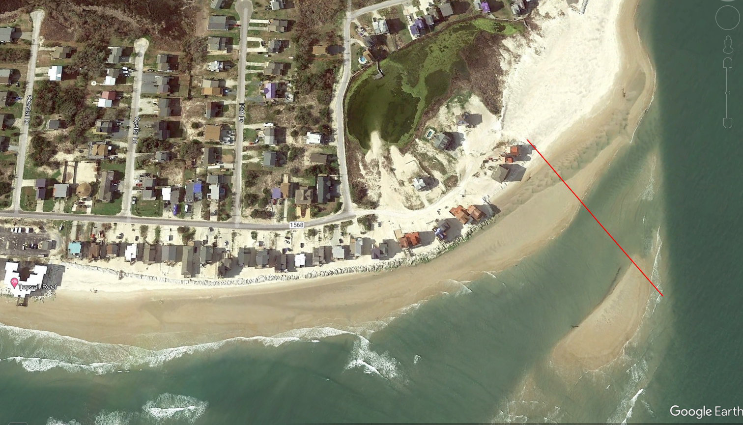
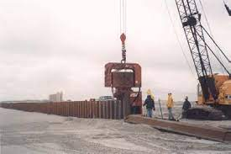
Temporary Terminal Groin as a Construction Item
Designed to Prevent Backflow of Nourishment Material into AIWW
Similar to Terminal Groin, But Removable and Recyclable
5 year Life Cycle Until Terminal Groin

Slide 9
Design Schedule
30 Year Concept Plan – December 2023
Stand Alone Permit for Reaches 1, 2 & 3 (DA143) - Dec 2023 - Nov 2024
Long Term Sand Source Development Jan 2024- December 2024
Finalization of 30 Year Plan, Including Permit - December 2025
Upon Completion of Reaches 1, 2, & 3 in FY26 Entire Town will be Engineered Bach.

Slide 10
Initial Construction Schedule
Winters FY 24 & FY 25 - Complete Reaches 5 & 4
Winter FY 26 - Complete Reaches 1, 2 & 3 (Maintenance on Reach 1)
Potential for Temporary Terminal Structure FY 26
Initial Inlet Improvement / Maintenance 1, 2 & 3 FY29
Cycle every 4 years w/ Small Hopper Maintenance Annually
Initial Hopper Maintenance FY 32
Cycle every 10 Years

Slide 11
Funding Opportunities
DA-143 – Shallow Draft Fund 3:1 State Match
Maintenance/Borrow from NRI – Shallow Draft Inlet Fund 3:1 State Match
Beach Resilience Fund (aka Reach 4) – State 1:1 Match
Directly Legislated State Grants
FEMA Assistance After Declared Disasters
Other County/State/Federal Opportunities yet Identified
ENOUGH FUNDING OPORTUNIES IDENTIFIED TO
CARRY LONG TERM PLAN WITHOUT CHANGE IN TAX RATE

Slide 12
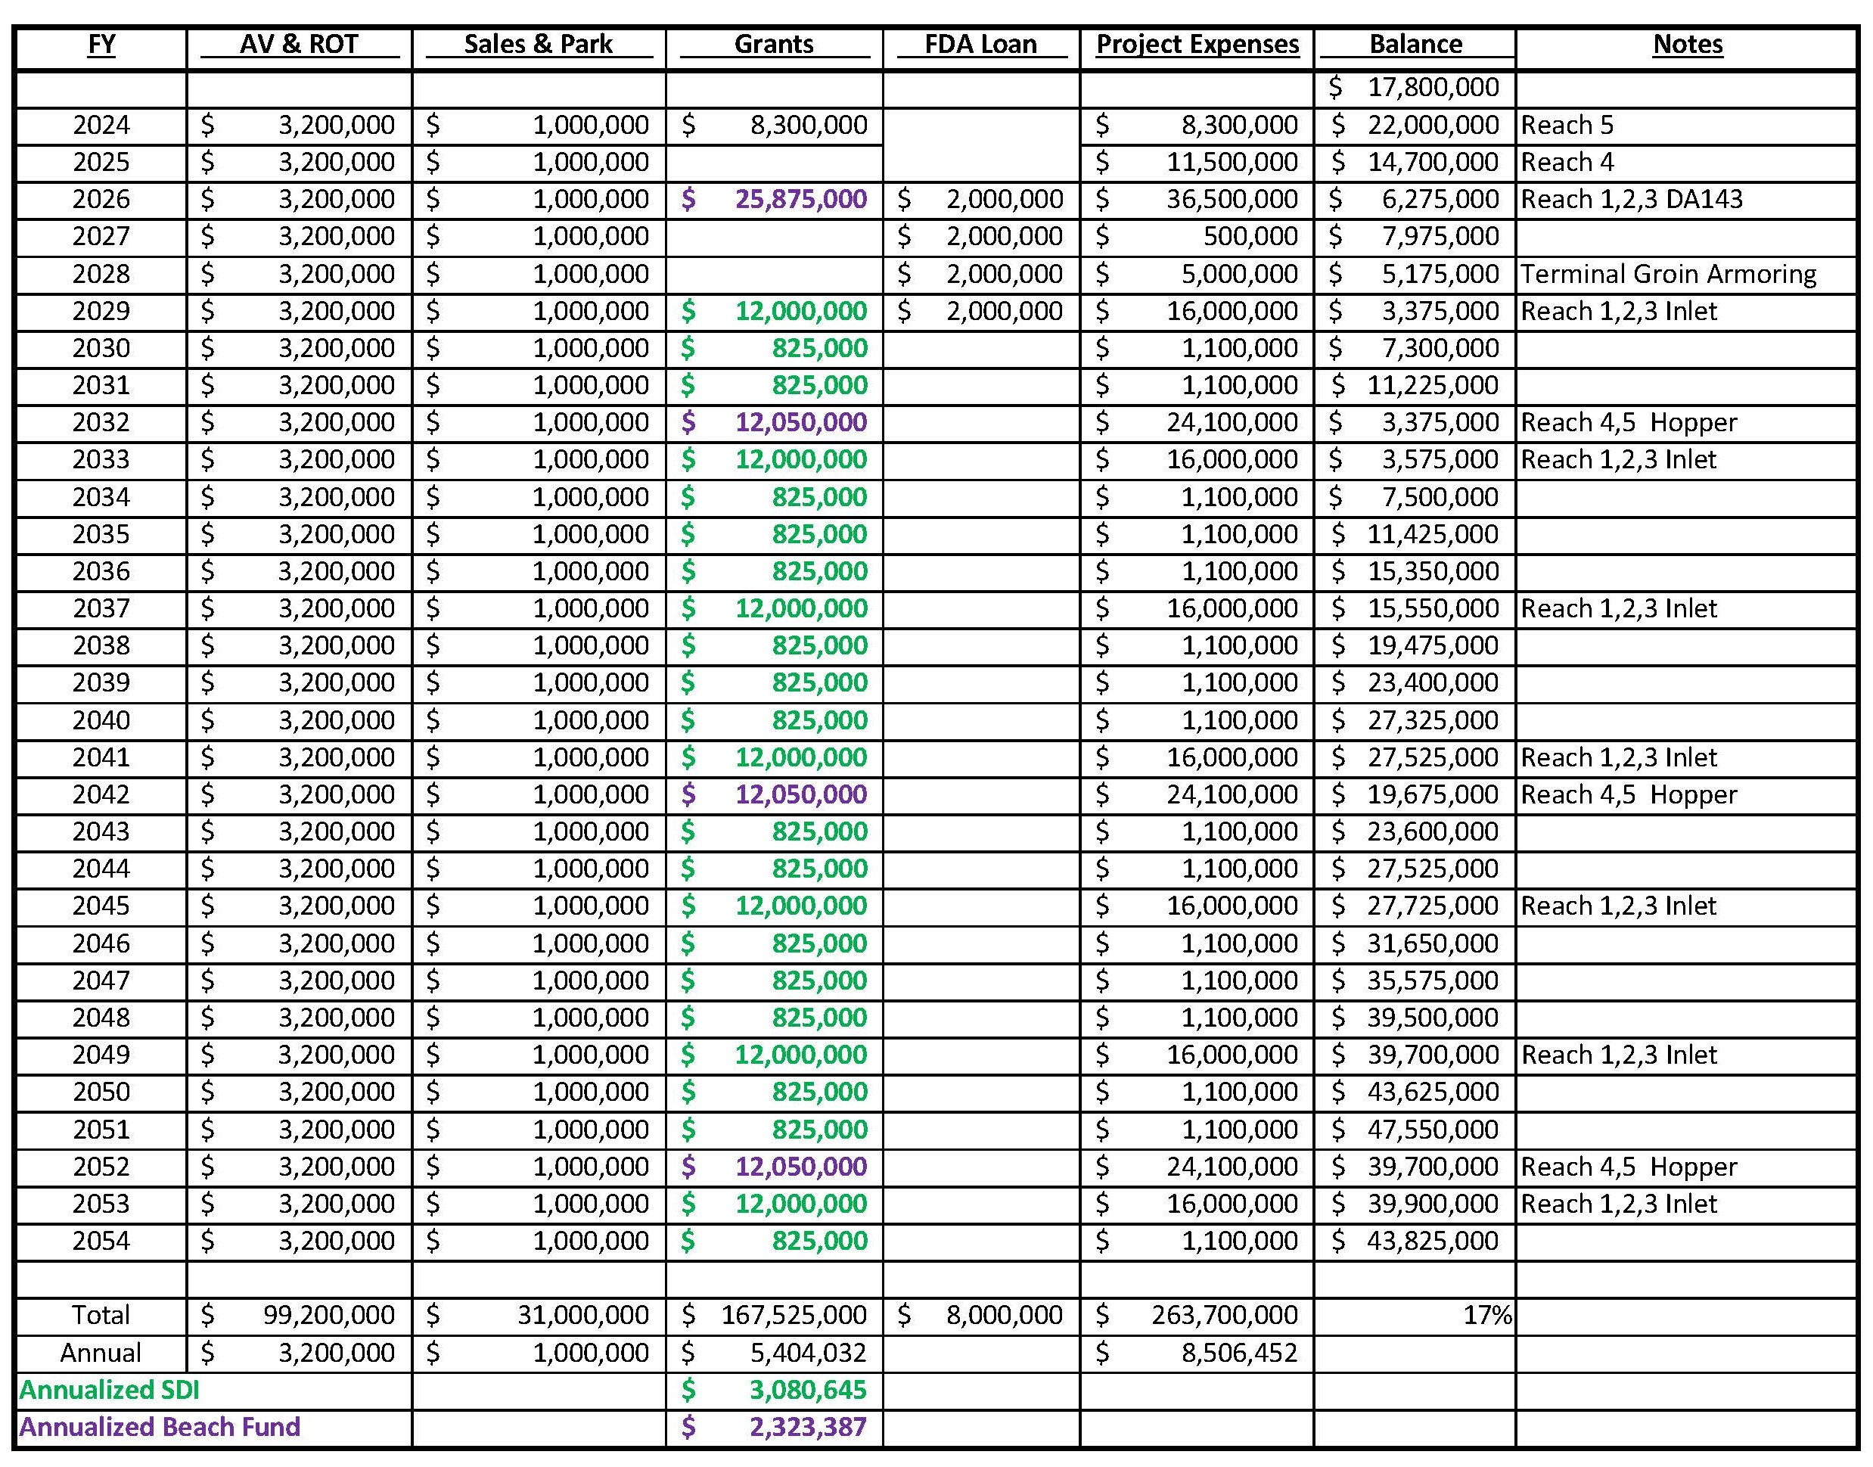

Slide 13
Non-Construction Expenses over FY 24 & FY25
FY-24
Surveys & Geotechnical Analysis of DA 143 $300,000
Engineering/ Design of Borrow Area & Beach Fill $150,000
FY-25
Environmental Analysis $ 75,000
Permitting/ Grant Applications $150,000
_____________________________________________________________
TOTAL $675,000

Slide 14
Questions?

