Slide 1
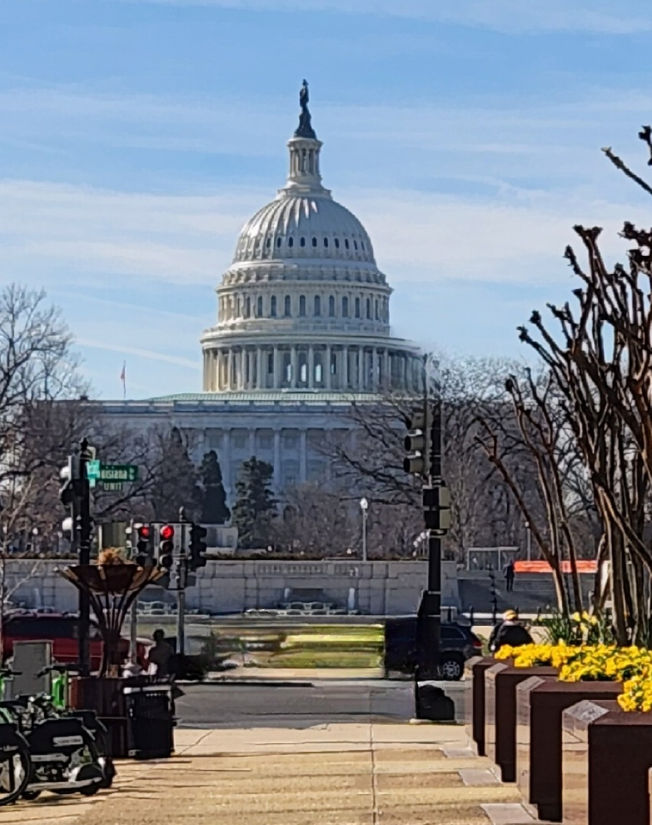
TISPC Washington, DC Legislative Visit
NTB Participants
Mayor Pro Tem Tom Leonard
Manager Alice Derian
April 28-30, 2025

Slide 2
Trip Objectives
Secure Senate Support for NTB CBRA Bill Passage
House Resolution 1885 & Companion Legislation
Continue Efforts with Congressional Staffs on HR-1885 for Passage and Support
Continued USACE Funding for Dredging of New River and New Topsail Inlets
Improve FEMA Island Wide Disaster Recovery Coordination

Slide 3
Meeting Schedule
Monday, April 28
Senator Tillis Key Staff
Secured Support for HR-1885 and Companion Senate Legislation
Continued Dredging Funds for New River and New Topsail Inlets and Connecting Channels
Legislative or Administrative Change to Use CBRA Zone Sand Outside CBRA Areas
U.S. Army Corps of Engineers
Town of Surf City Federal Project
Continued Dredging Funds for New River and New Topsail Inlets and Connecting Channels
Legislative or Administrative Change to Use CBRA Zone Sand Outside CBRA Areas
House Committee Staff, Natural Resources Subcommittee on Water, Wildlife and Fisheries
HR-1885 Next Step
Subcommittee Hearing May 20, 2025, 10:15 AM

Slide 4
Meeting Schedule
Tuesday, April 29
House Transportation and Infrastructure Committee -Subcommittee on Water Resources and Environment
Continued Dredging Funds for New River and New Topsail Inlets and Connecting Channels
Legislative or Administrative Change to Use CBRA Zone Sand Outside CBRA Areas
Surf City Project
Congressman David Rouzer and Staff
Appreciation for HR-1885 Co-sponsorship and Continued Support
Continued Dredging Funds for New River and New Topsail Inlets and Connecting Channels
Legislative or Administrative Change to Use CBRA Zone Sand Outside CBRA Areas

Slide 5
Meeting Schedule
Tuesday, April 29 – Continued
Congressman Murphy and Legislative Assistant Ray Celeste
Continued Support and Assistance HR-1885
Continued Dredging Funds for New River and New Topsail Inlets and Connecting Channels
Legislative or Administrative Change to Use CBRA Zone Sand Outside CBRA Areas
Senator Budd Key Staff
Requested and Secured Support for HR-1885 and Companion Legislation
Continued Dredging Funds for New River and New Topsail Inlets and Connecting Channels
Legislative or Administrative Change to Use CBRA Zone Sand Outside CBRA Areas

Slide 6
Meeting Schedule
Wednesday, April 30
Senate Environment and Public Works Committee
Support for HR-1885 and Companion Senate Legislation
Continued Dredging Funds for New River and New Topsail Inlets and Connecting Channels
Legislative or Administrative Change to Use CBRA Zone Sand Outside CBRA Areas

Slide 7
H.R. 1885
Introduced by Congressman Murphy, March 5, 2025
Co-sponsored by Congressman Rouzer
Referred to the House Committee on Natural Resources, March 5, 2025
Water, Wildlife and Fisheries Subcommittee Hearing May 20, 2025

Slide 8
What’s Next?
CBO Scoring
House Floor
Possibly Part of Larger CBRA Bill
Companion Senate Bill

Slide 9
How Can I Help?
Write to Senators Budd and Tillis
Write to Members of Congress
Out of State Property Owners
Ask Your Representatives to please support H.R. 1885

Slide 10
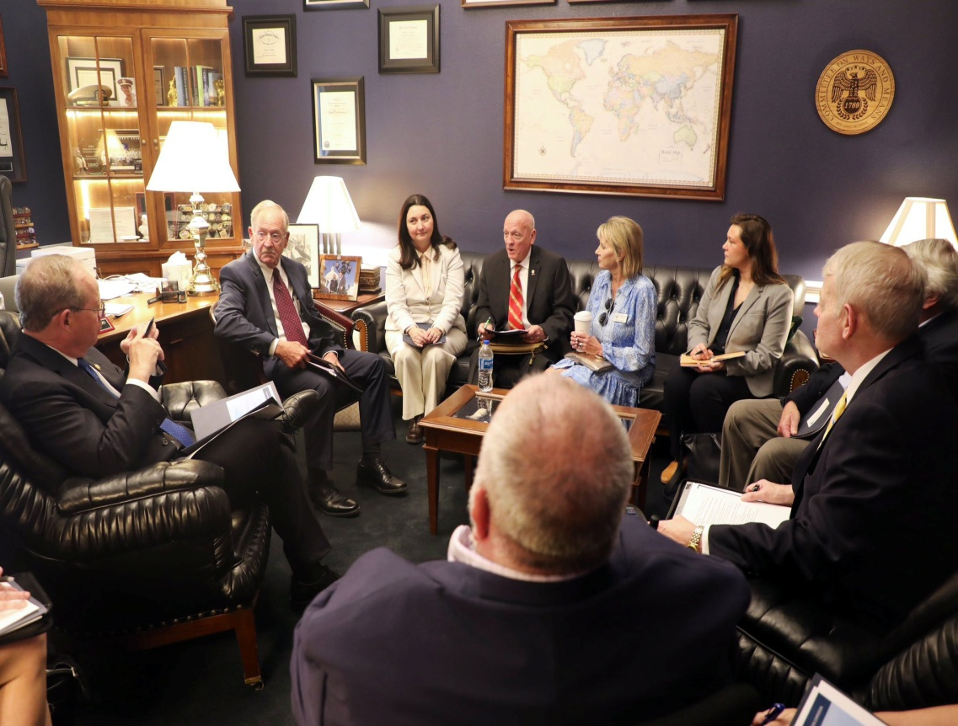
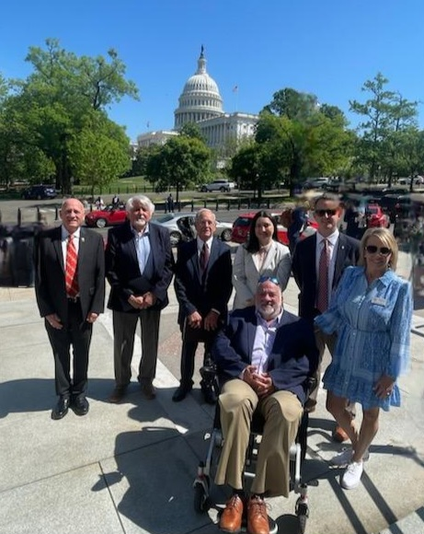
Questions?

