Slide 1
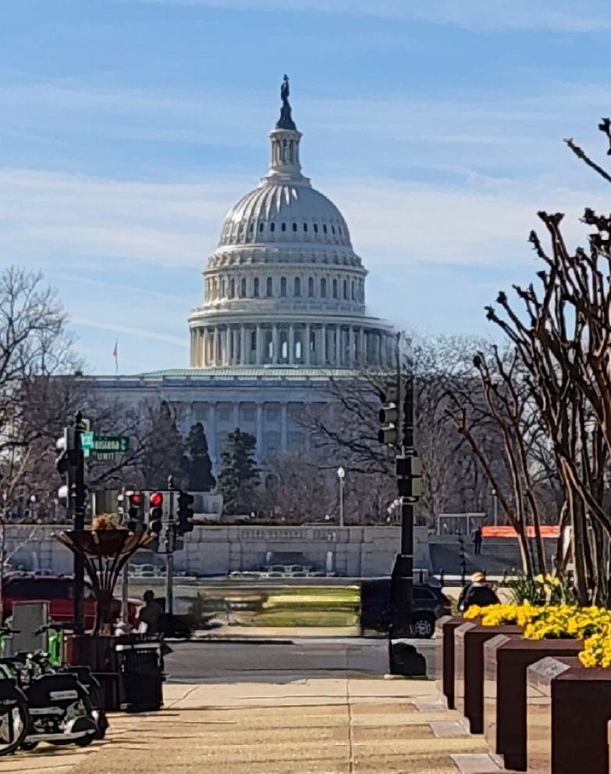
TISPC Washington, DC Legislative Visit
NTB Participants
Alderman Tom Leonard
Manager Alice Derian
April 15-17, 2024

Slide 2
Trip Objectives
Secure Senate Support for NTB CBRA Bill Passage
House Resolution 2437 & Companion Legislation
Continue Efforts with Congressional Staffs on HR-2437 for Passage and Support
Continued USACE Funding for Dredging of New River and New Topsail Inlets
Use of Sand from USACE AIWW Disposal Areas for Beach Projects (DA-143)
Improve FEMA Island Wide Disaster Recovery Coordination

Slide 3
Meeting Schedule
Monday, April 15
TISPC In-briefing with The Ferguson Group
FEMA Region 4
Agreed to one Topsail Island PDMG Per Future Storm Event
Mr. Doug Levine, House Committee on Natural Resources Subcommittee on Water, Wildlife and Fisheries
HR-2437 Next Steps
CBO Scoring Process and Timeline
Agreed to Follow-up and Monitor Progress

Slide 4
Meeting Schedule
Tuesday, April 16
Senator Ted Budd and Staff
Requested and Secured Support for HR-2437 (NTB CBRA Bill) and Follow-on Legislation
Congressman David Rouzer and Staff
Appreciation for HR-2437 Co-sponsorship and Continued Support

Slide 5
Meeting Schedule
Tuesday, April 16 – Continued
Congressman Murphy and Legislative Assistant Ray Celeste
Continued Support and Assistance HR-2437
NTB Visit by Representative from U.S. Fish and Wildlife Service
USFWS Testified in Opposition of HB-2437.
Formal Request by Congressman Murphy that USFWS Visit NTB to Better Understand our CBRA Situation
Senator Thom Tillis Key Staff
Requested and Secured Support for HR-2437 and Follow-on Legislation

Slide 6
Meeting Schedule
Wednesday, April 17
U.S. Army Corps of Engineers
Town of Surf City Federal Project Start Date
No Confirmation
North Topsail Beach Future Use of DA-143 for Projects
USACE Agreed No Further Study Required
USACE to Coordinate Same with Wilmington District
Continued Dredging Funds for New River and New Topsail Inlets and Connecting Channels

Slide 7
H.R. 2437
Introduced by Congressman Murphy, March 30, 2023
Co-sponsored by Congressman Rouzer
Referred to the House Committee on Natural Resources, March 30, 2023
Water, Wildlife and Fisheries Subcommittee Hearing September 28, 2023
Passed Full Committee, November 15, 2023

Slide 8
What’s Next?
CBO Scoring
Currently Underway
House Floor
Most Likely Part of Larger CBRA Bill
Companion Senate Bill

Slide 9
How Can I Help?
Write to Senators Budd and Tillis
Write to Members of Congress
Out of State Property Owners
Ask Your Representatives to please support H.R. 2437

Slide 10
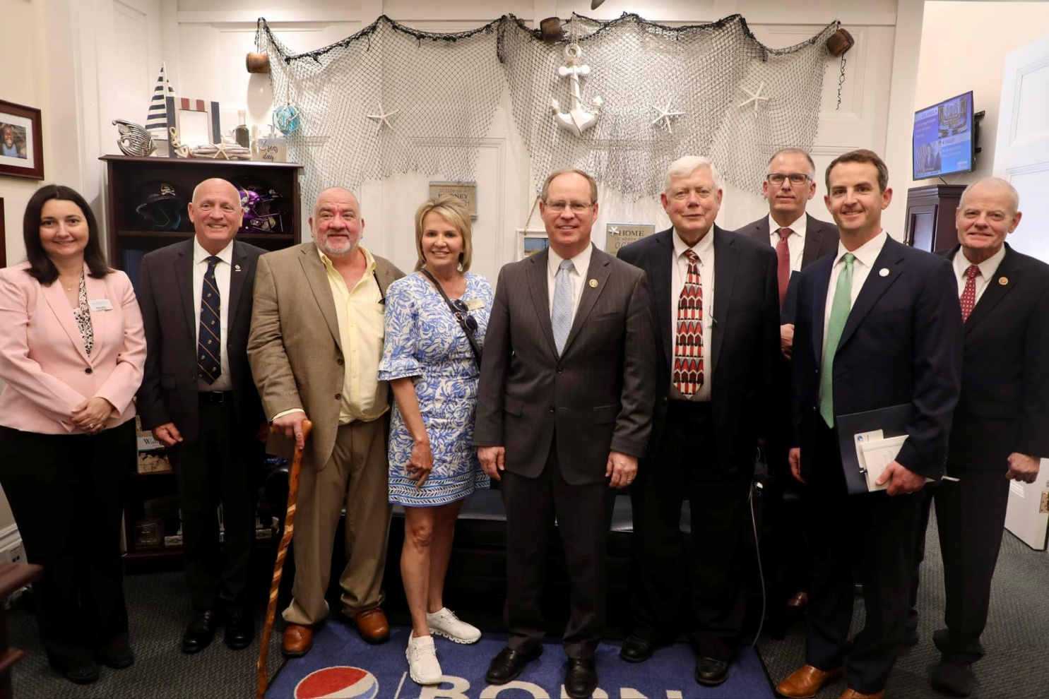
Questions?

