Slide 1
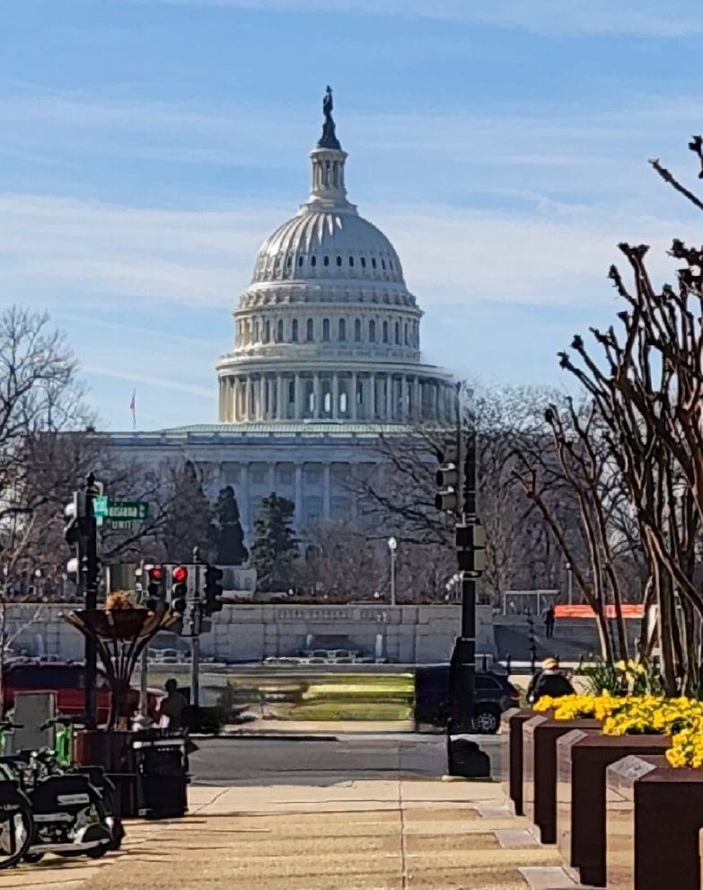
North Topsail Beach Washington, DC Legislative Visit
Mayor Joann McDermon
Manager Alice Derian
Alderman Tom Leonard
March 20-24, 2023

Slide 2
Meeting Schedule
Tuesday, March 21
TISPC Inbriefing with The Ferguson Group
Mr. Ryan Hambleton, Staff Director, House Subcommittee on Water Resources and Environment

Slide 3
Meeting Schedule
Wednesday, March 22
Senator Ted Budd and Staff
Senator Thom Tillis Key Staff
Congressman David Rouzer and Staff
U.S. Army Corps of Engineers

Slide 4
Meeting Schedule
Thursday, March 23
Mr. Kiel Weaver, Staff Director, House Committee on Natural Resources Subcommittee on Water, Wildlife and Fisheries
Congressman Greg Murphy and Legislative Assistant Ray Celeste

Slide 5
H.R. 2437
Introduced by Congressman Murphy, March 30, 2023
Co-sponsored by Congressman Rouzer
Referred to the House Committee on Natural Resources, March 30, 2023

Slide 6
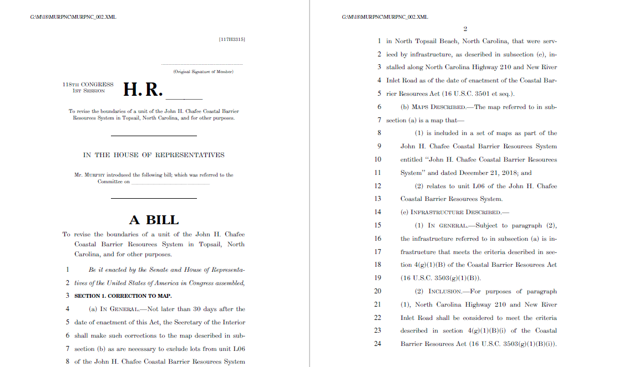
H.R. 2437

Slide 7
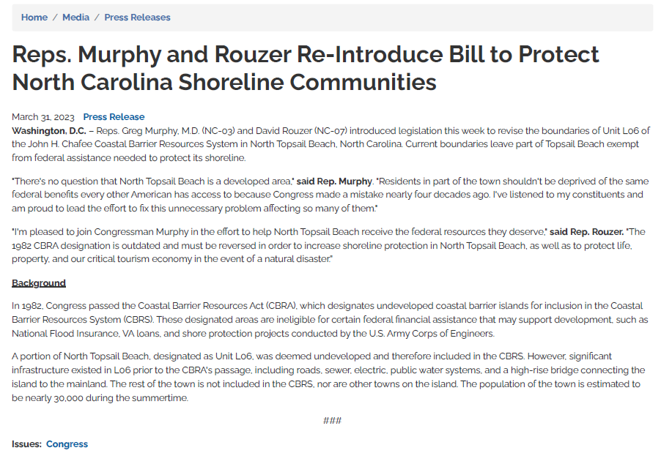

Slide 8
Links
https://www.congress.gov/bill/118th-congress/house-bill/2437
https://murphy.house.gov/media/press-releases/reps-murphy-and-rouzer-re-introduce-bill-protect-north-carolina-shoreline

Slide 9
What’s Next?
Resolution Thanking Congressmen Murphy & Rouzer
Continue discussions with Congressman Murphy’s office
Continue discussions with The Ferguson Group
Companion Senate Bill - Mike McIntyre

Slide 10
How Can I Help?
Write to Congressmen Murphy and Rouzer
Write to members of House Committee on Natural Resources:
https://naturalresources.house.gov/about/members.htm
No NC Members on Committee
Out of State Property Owners
Ask Representatives to please support H.B. 2437

Slide 11
House Committee on Natural Resources Members
Republicans:
AR - Westerman
CO - Lamborn,
VA - Wittman, Boebert
AZ - Gosar
LA - Graves
FL - Webster, Luna ID - Fulcher MN - Stauber
UT- Curtis
WI - Tiffany
AL - Carl
MT - Rosendale
OR - Bentz
TX - Hunt
GA - Collins
WY – Hageman
CA – McClintock, LaMalfa, Duarte
PR - Gonzalez-Colon
Am Samoa - Radewagen
Guam- Moylan
Democrats:
AZ - Grijalva, Gallego
CO - Neguse
NM - Fernandez, Stansbury
AK - Peltola
NY - Velazquez, Ocasio-Cortez
OR - Hoyle
RI - Magaziner
HI - Case
MI - Dingell
NE - Lee
CA – Napolitano. Huffman, Levin,
Porter, Mullin, Kamlager-Dove
Northern Mariana Islands - Sablan

