Slide 1
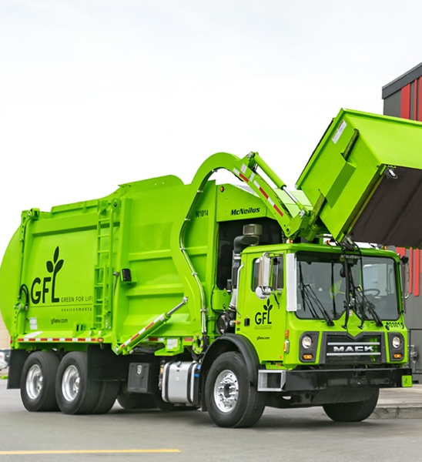

A Guide to Solid Waste Success!

Slide 2

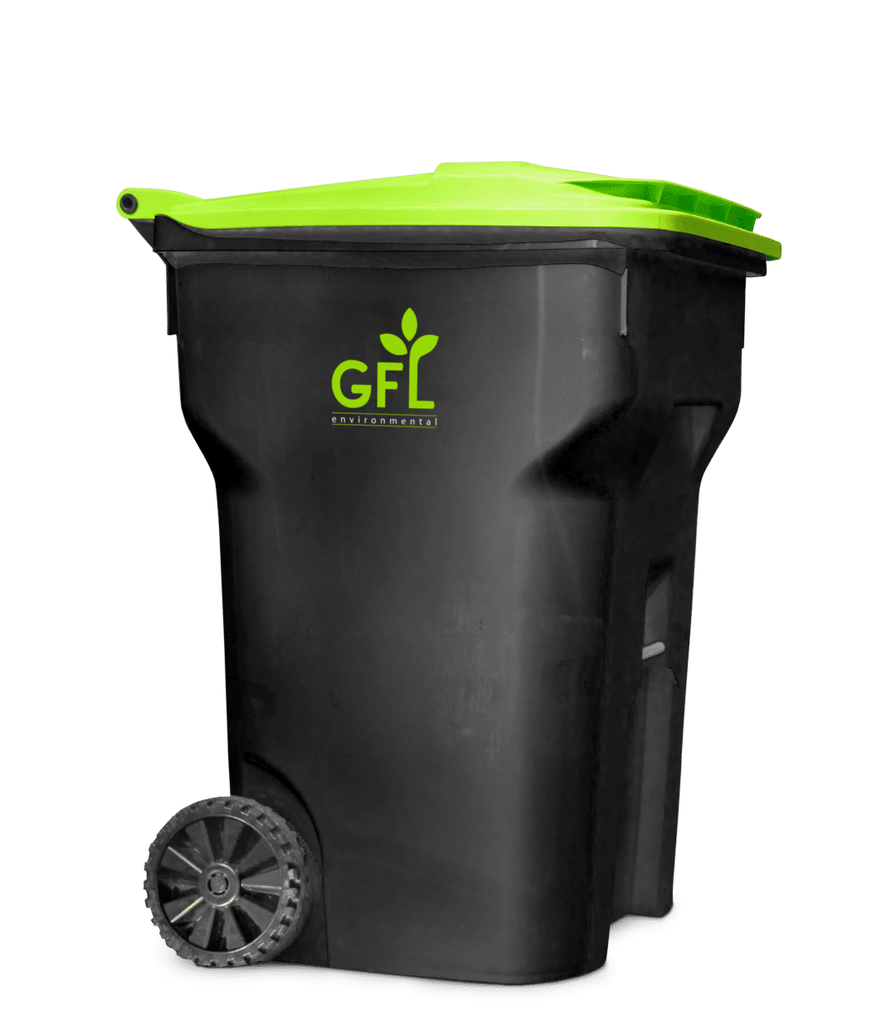
Who to contact?
For NEW residents establishing service:
Call 910-650-0863 or email chuckaby@northtopsailbeachnc.gov
*You MUST have your address, and ONWASA information to verify with our staff.
For Service Complaints, Broken or Damaged and Missing carts:
Call GFLs customer service line at 252-339-0290
GFL will be the resource to answer any and all questions concerning schedules, fees, do’s and don’ts, as well as bulk item pickups for households.

Slide 3
Who to contact?
Public Works
We can assist with any concerns which become repetitive like missed pickups, etc.
Public Works does not enforce code, nor do we handle billing or payments. This is something we assist residents with due to its adjacency to the GFL services at our public beach access and collection sites.
Code Enforcement
For any questions about code enforcement on the ordinances found here https://codelibrary.amlegal.com/codes/northtopsailbeach/latest/topsail_nc/0-0-0-2088 related to residential solid waste, call 910-581-2042.

Slide 4
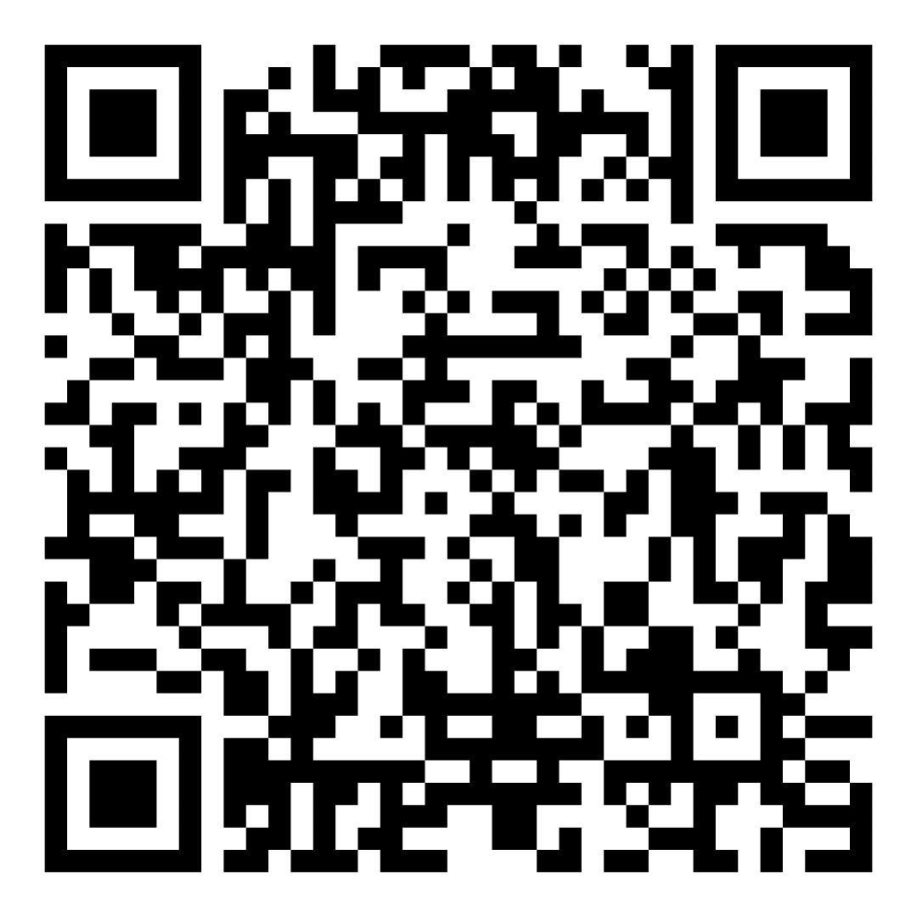
Registering Your Cans
Steps for NEW residents establishing service:
Scan the QR Code at the bottom of this slide.
Click megaphone icon under SUBMIT REQUEST: section
Provide your;
Full name
Email address
Description of Issue (REQUESTING CART, REGISTERING CART, REQUEST CART REMOVAL)
Phone number
Location/address (tap the map to assist you)
Work Type (please select OTHER)
Upload photographs of your carts for REGISTERING CART (serial numbers located on the front of cart)
Submit!
Public Works will receive your request and contact you if needed. You will receive a request confirmation number for reference, please keep this for your records!

Slide 5
A Guide to Solid Waste Success!
TRASH
Pictured here, with a black chassis and bright green lid, is your TRASH CAN
This can should have a “hot stamp” on the lid with “TRASH ONLY” or similar identifier.
These cans are tracked by the town and GFL by serial number related to your addresses which are required per town ordinance
Here is a link to the Waste and Recycling schedules, fees, rules, and other important information! https://www.northtopsailbeachnc.gov/wm/page/waste-recycling

Slide 6
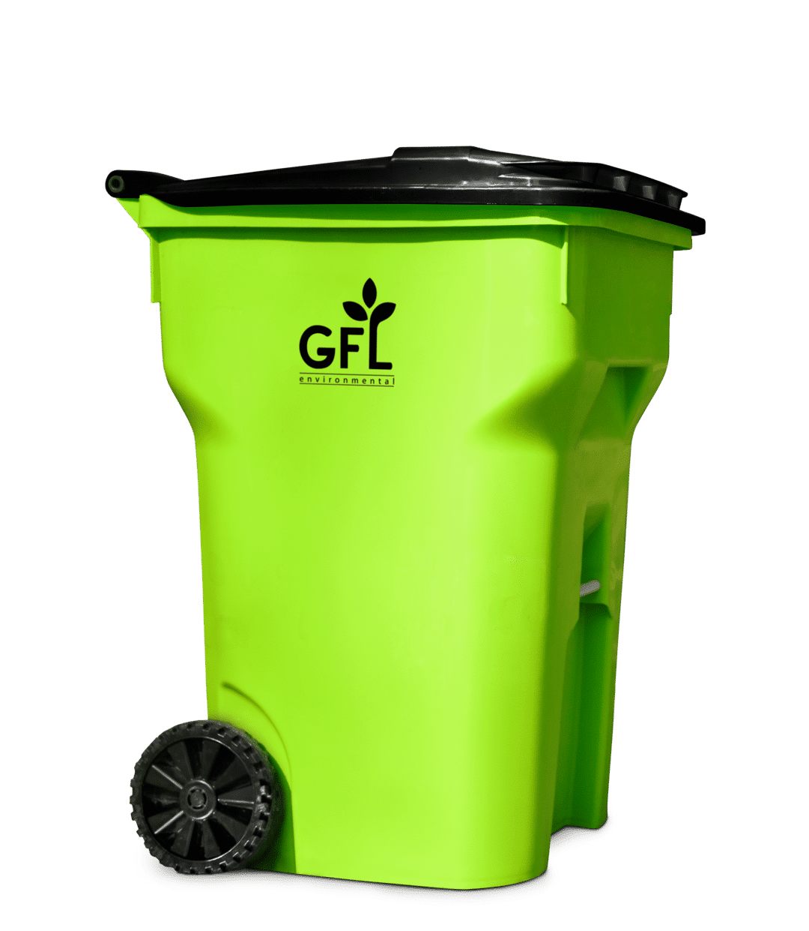
A Guide to Solid Waste Success!
RECYCLE
Pictured here, with a green chassis and black lid, is your RECYCLE CAN
This can should have a “hot stamp” on the lid with “RECYCLE ONLY” or similar identifier.
These cans are tracked by the town and GFL by serial number related to your addresses which are required per town ordinance
Here is a link to the Waste and Recycling schedules, fees, rules, and other important information! https://www.northtopsailbeachnc.gov/wm/page/waste-recycling

Slide 7
Town Codes

Slide 8
A Guide to Solid Waste Success! – Town Ordinance Codes
§ 13-1 DEFINITIONS. https://codelibrary.amlegal.com/codes/northtopsailbeach/latest/topsail_nc/0-0-0-2102
§ 13-2 REFUSE REQUIRED TO BE DEPOSITED IN APPROVED CONTAINERS. https://codelibrary.amlegal.com/codes/northtopsailbeach/latest/topsail_nc/0-0-0-2111
§ 13-5 CONTAINERS REQUIRED. https://codelibrary.amlegal.com/codes/northtopsailbeach/latest/topsail_nc/0-0-0-2120
(a) All occupants of each premises, against which a charge for the collection and disposal of garbage and rubbish is levied in accordance with the provisions of this chapter, shall be provided a container by the town or by the contractor providing solid waste disposal services in accordance with a contract with the town. The occupants of such premises shall be required to deposit all garbage and refuse existing at such premises in the containers so provided, subject to the terms and conditions of this chapter. All containers so provided shall be kept in a reasonably clean manner.
(b) All occupants of each premises not wishing to participate with town collection services provided are required to contract with a solid waste disposal service.
(c) Owners or agents of owners with rental property/properties shall participate with the town solid waste program or participate with a solid waste contractor for solid waste disposal services.
(Ord. passed 6-1-1995) Penalty, see § 1-5
§ 13-8 UNLAWFUL TO DISPLACE CONTAINERS.
https://codelibrary.amlegal.com/codes/northtopsailbeach/latest/topsail_nc/0-0-0-2135
It shall be unlawful for any person to damage or otherwise interfere with garbage containers or their contents, or to take, carry away or steal any container with the intent or effect of depriving the owner and/or designated user of the use and benefit of said container for any period of time.
(Ord. passed 6-1-1995) Penalty, see § 1-5

